Slide 1
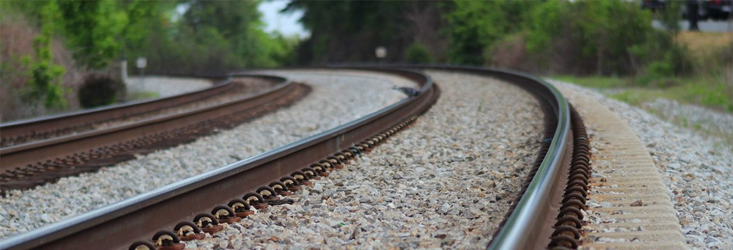
Automatic Identification of Mudspot Areas from Railroad Linescan Images with CNN
Qing Zhang, 13/05/2022

Slide 2
Workflow
Locating Rails
Stitching
Locating Sleepers
Extract Crib Images
Break Down to Regular Segment Images (256x256 pixels).
CNN classification.

Slide 3
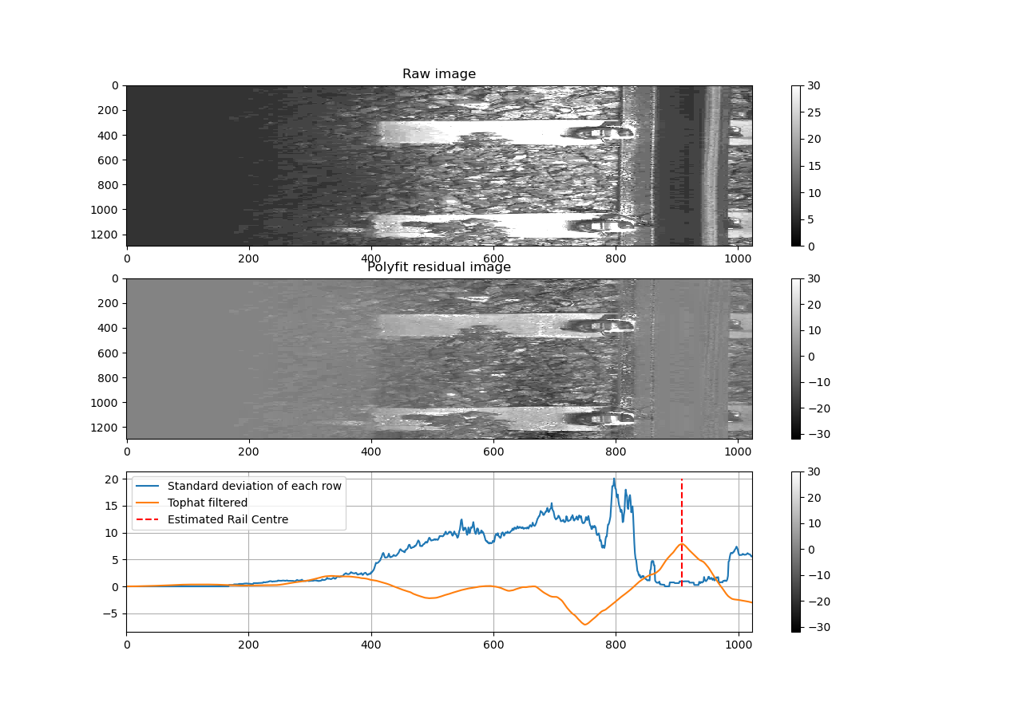
Locating Rails
Camera View angle suffers fluctuation due to curve turns and vibrations.
Stitching point is not constant
The best place is the centre of the rail.
Rail surface reflection has to be taken into account

Slide 4
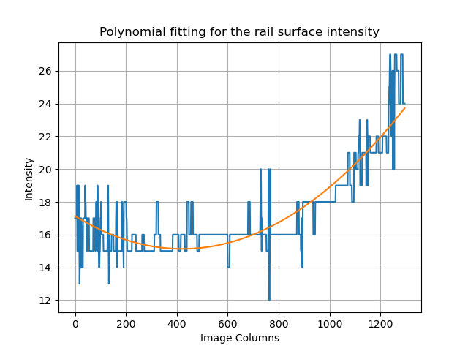
Locating Rails
The aim is:
The metal rail surface suffers a illumination gradient.
Polynomial fitting to turn the rail section into a “flat” surface.
Rails can be located by looking at the standard deviation of each image column.

Slide 5
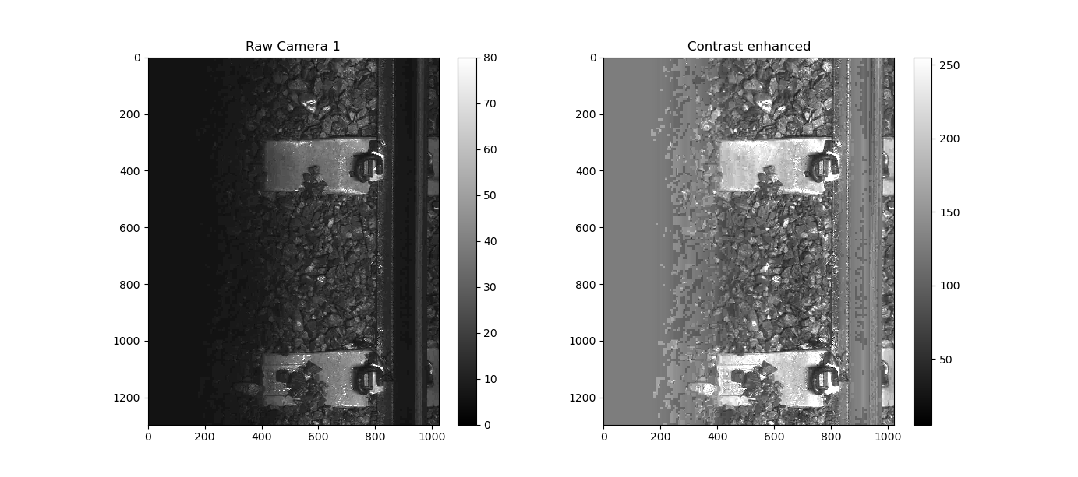
Stitching
Contrast enhancement to improve the poor illustration of the raw image.

Slide 6
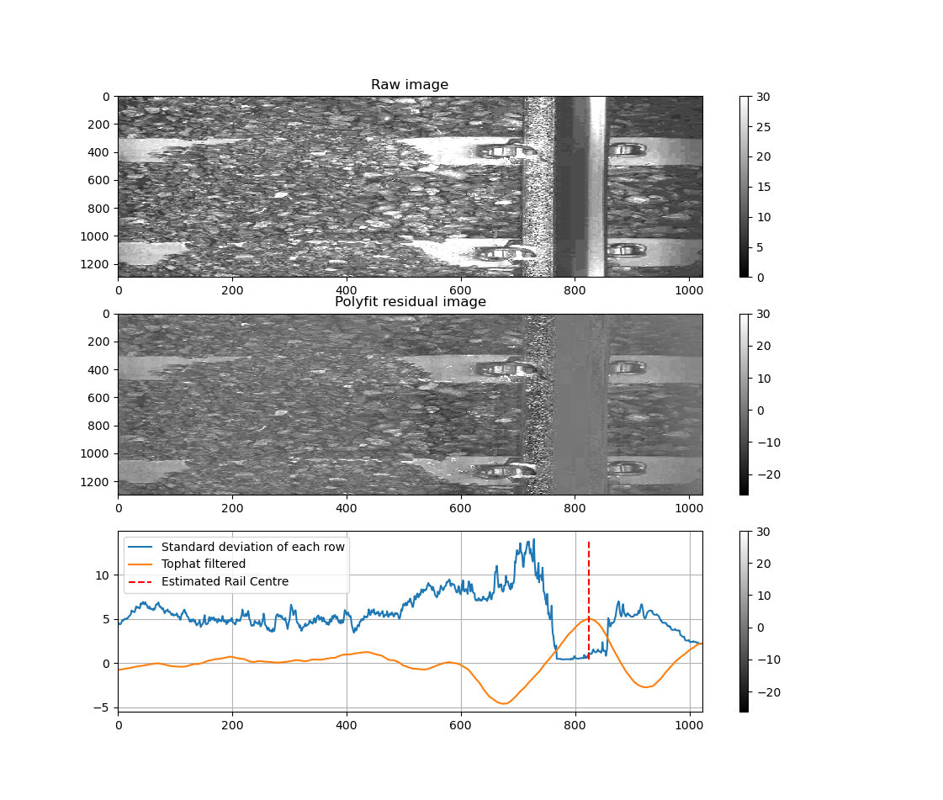
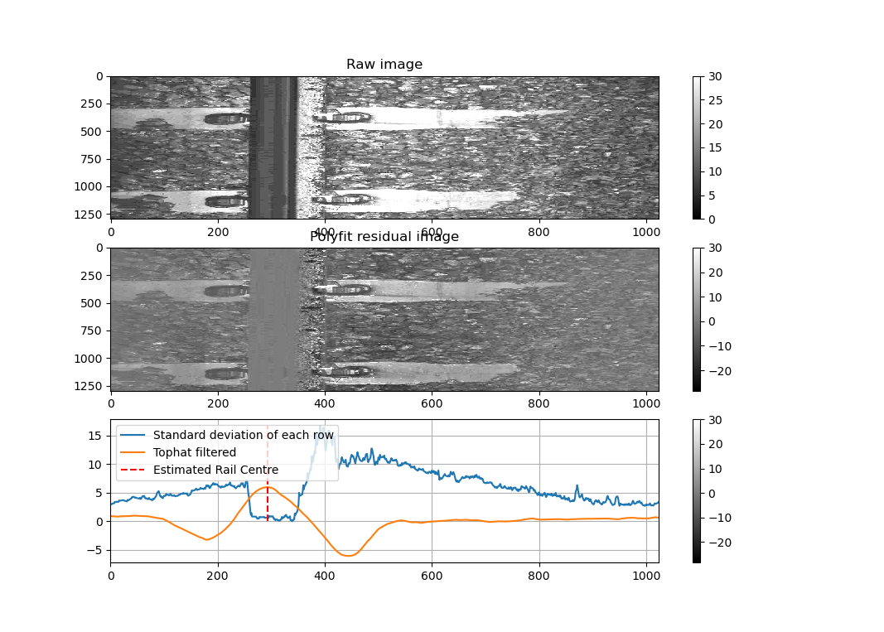
Stitching
Camera 1 and 2 are stitched at rail centre point

Slide 7
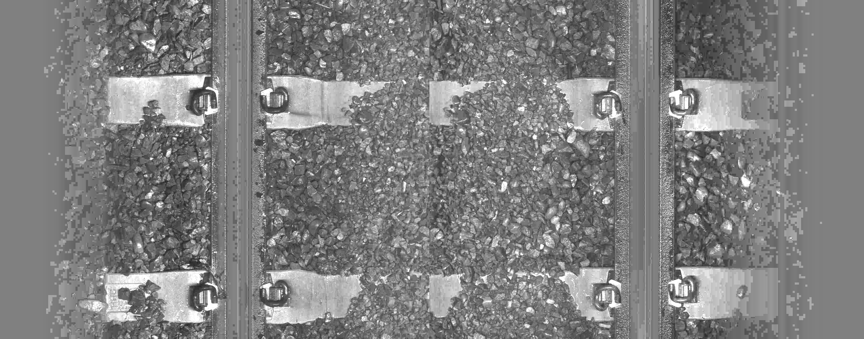
Stitching
The middle joint point has to be derived manually.

Slide 8
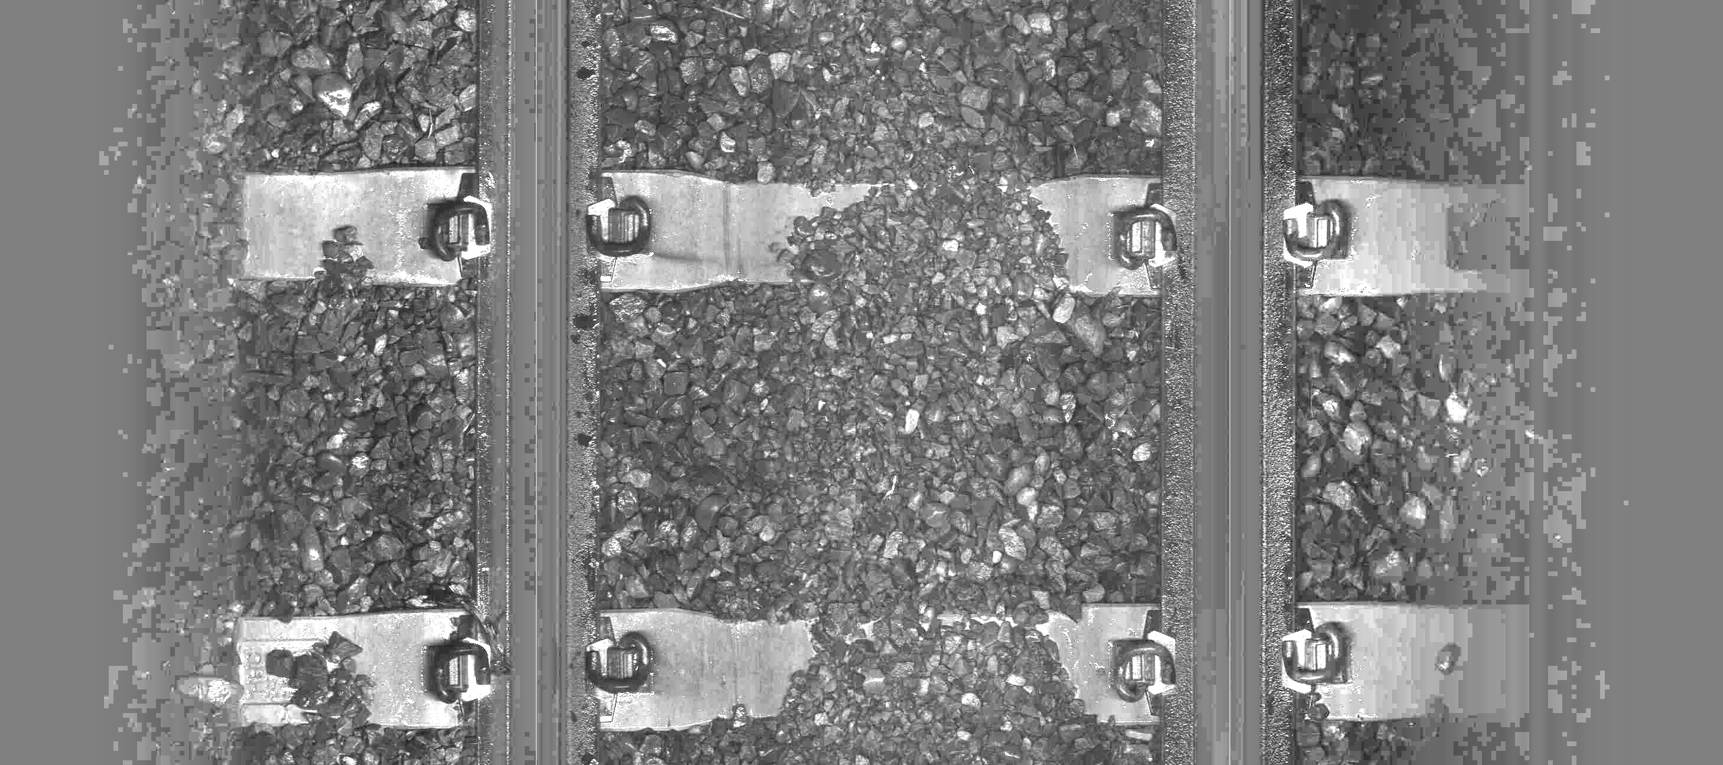
Stitching
Middle joint point suffers fluctuation due to vibration and curve turns.
To investigate: the relation between the rail centre points and middle joint point.

Slide 9
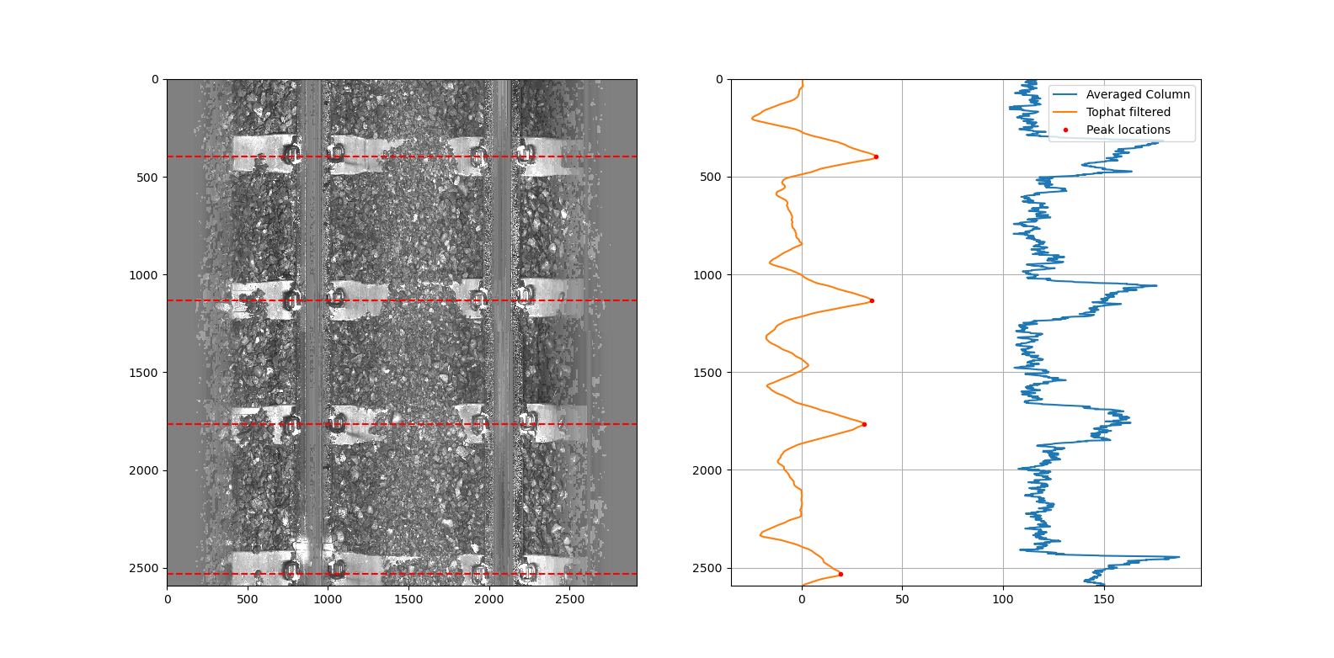
Locating Sleepers
Stacking columns between two rails.
The consistent brightness of sleepers VS the random fluctuation of ballast intensity.
Tophat filtering to locate the centres

Slide 10
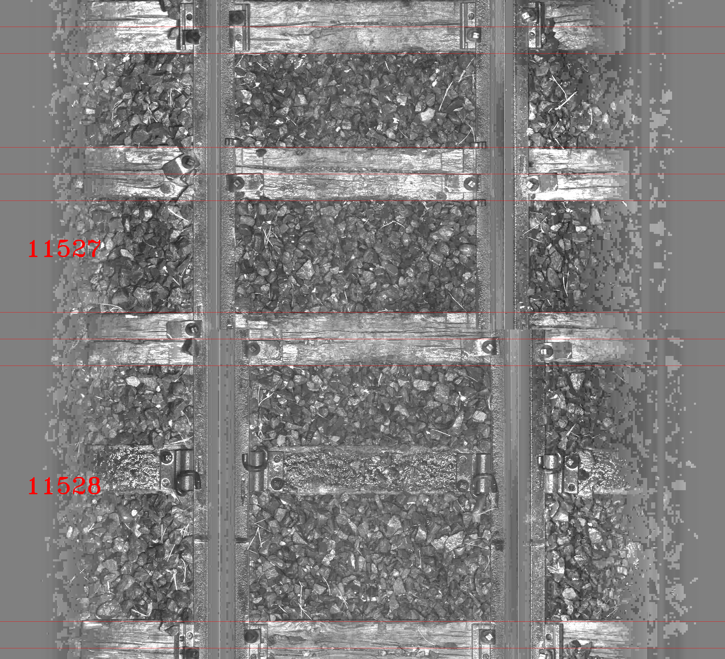
Locating Sleepers
Wooden sleepers suffer misses due to low intensity of reflections.

Slide 11
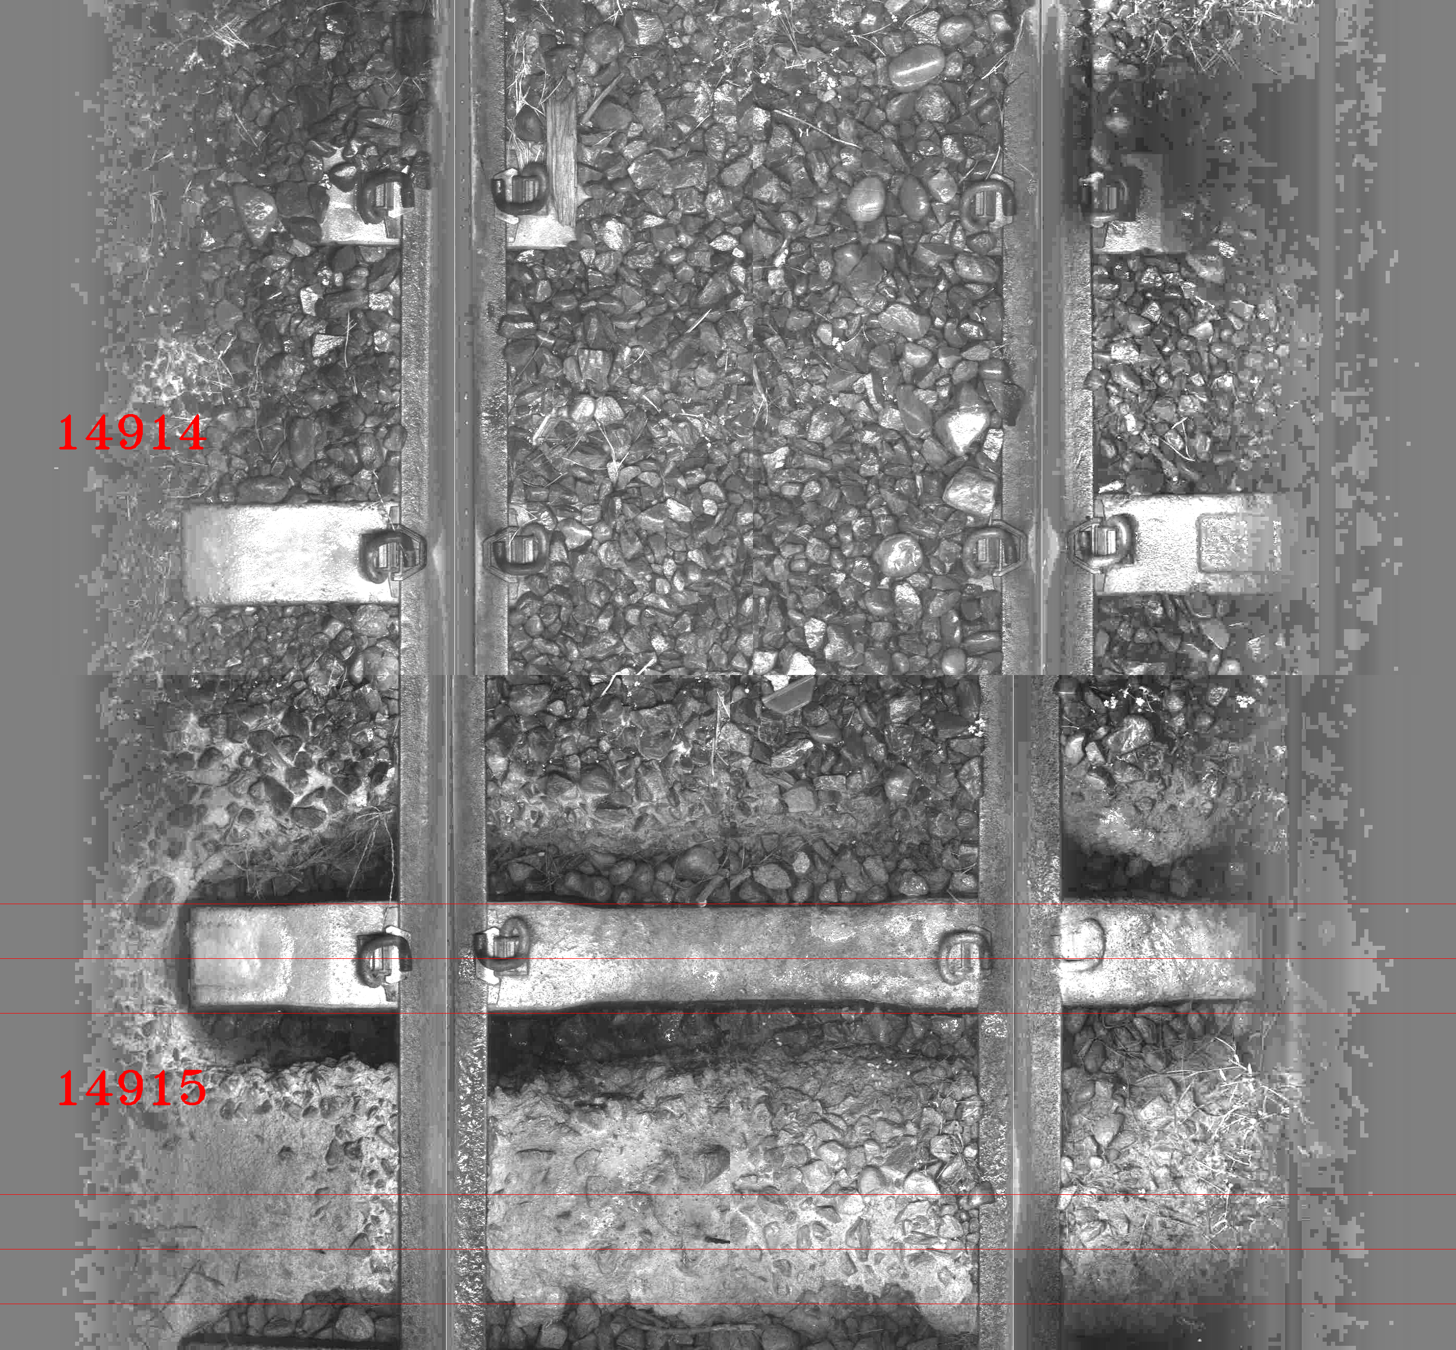
Locating Sleepers
False positive at really reflective surface, for example mud.

Slide 12
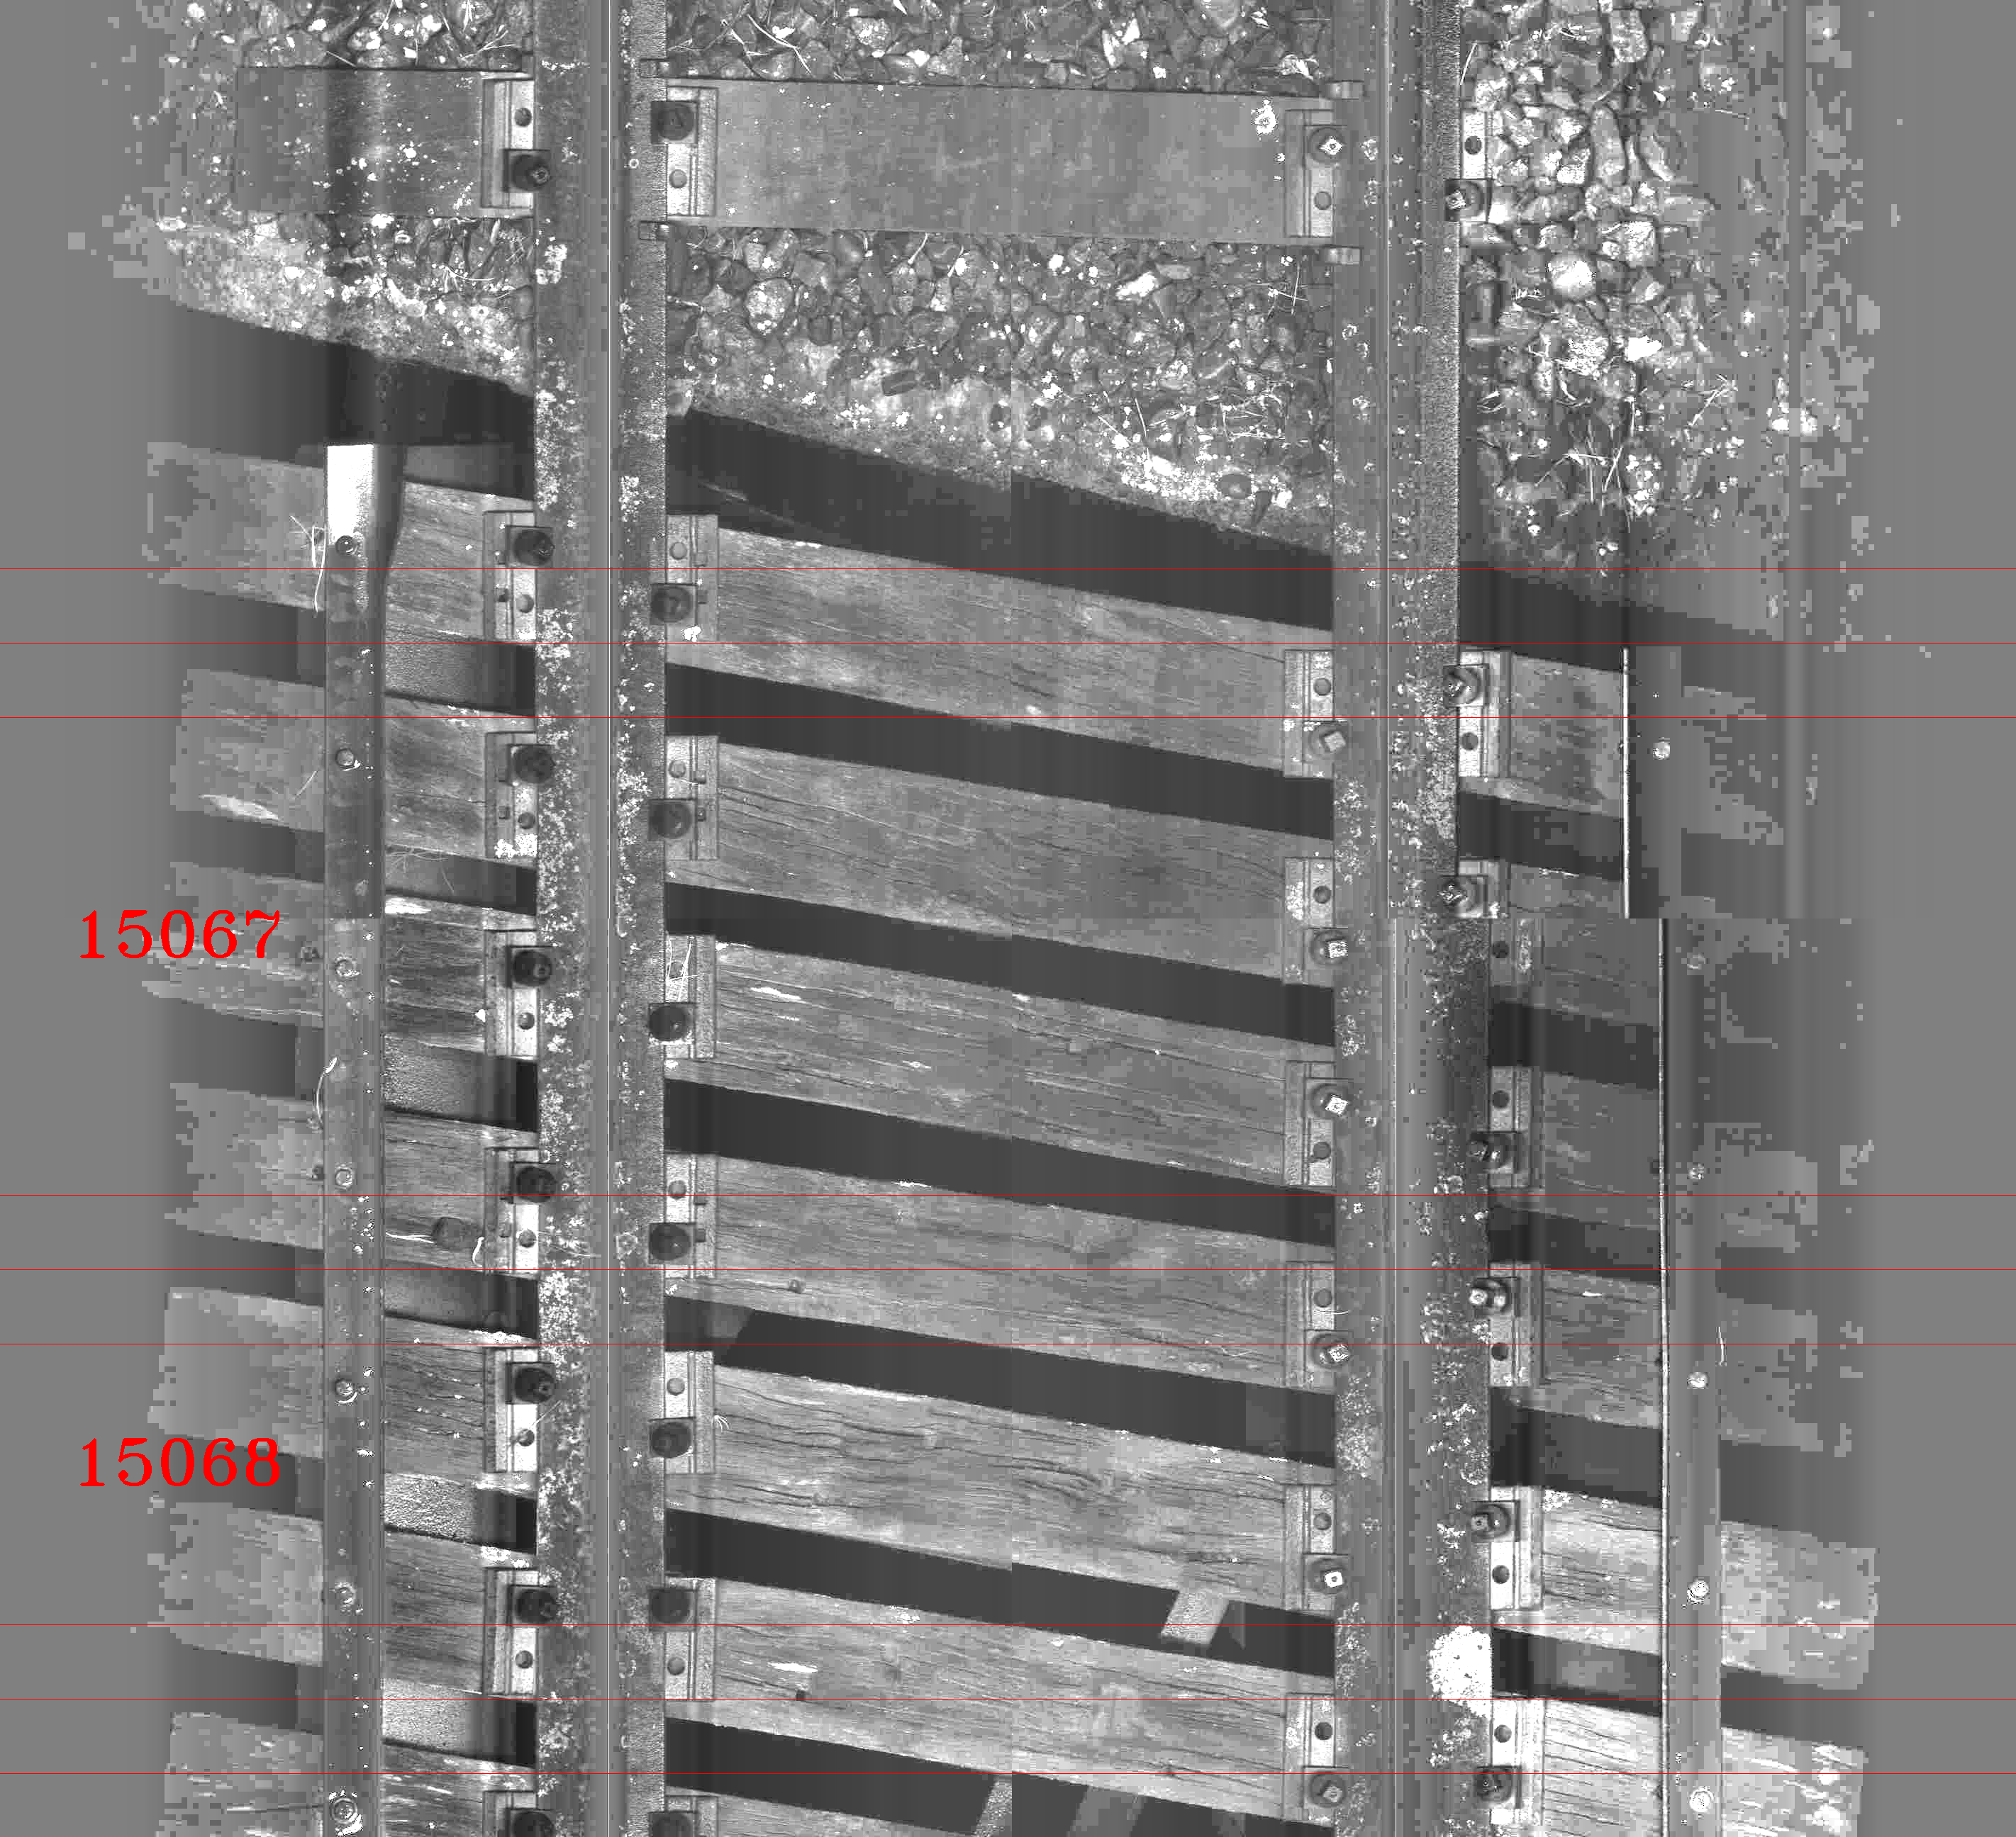
Locating Sleepers
Complete chaos at wooden structures.

Slide 13
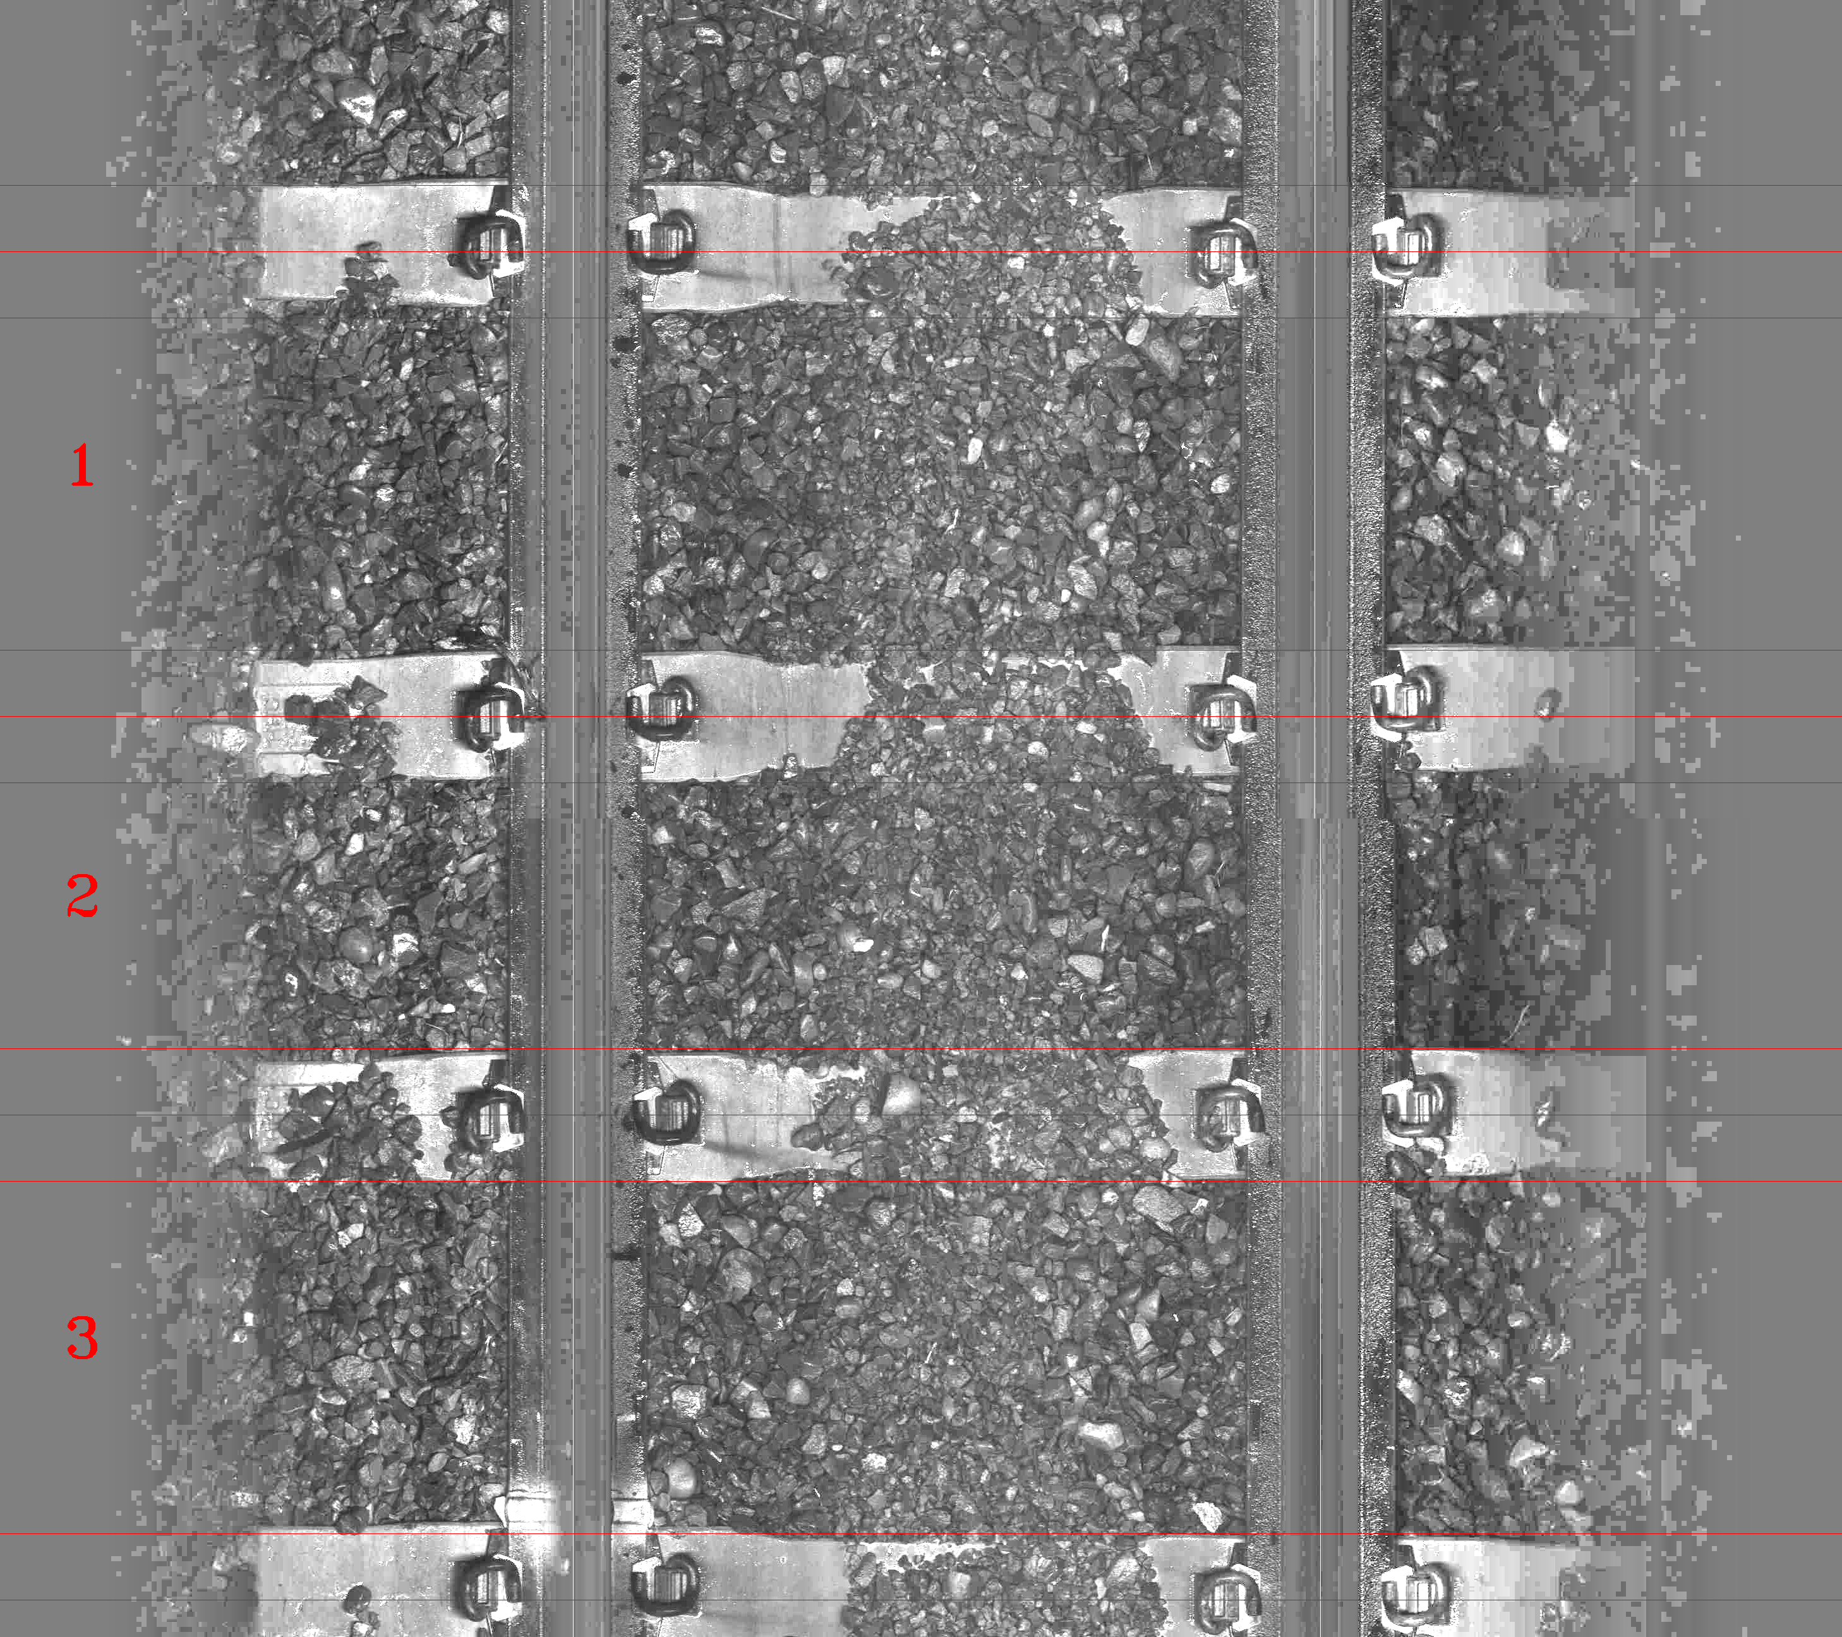
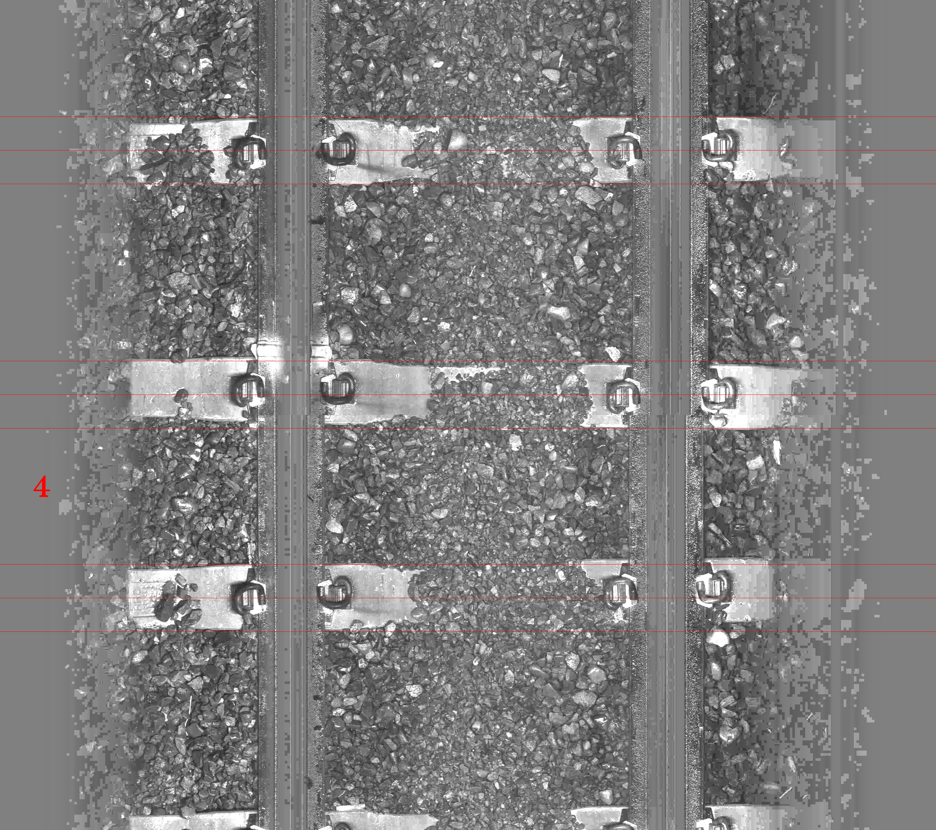
Crib Counting
Assume the rails and the sleepers have a fixed width.
Every two images are stacked up to guarantee at least 2 complete cribs.
We can’t guarantee to have a complete crib within a single image.

Slide 14
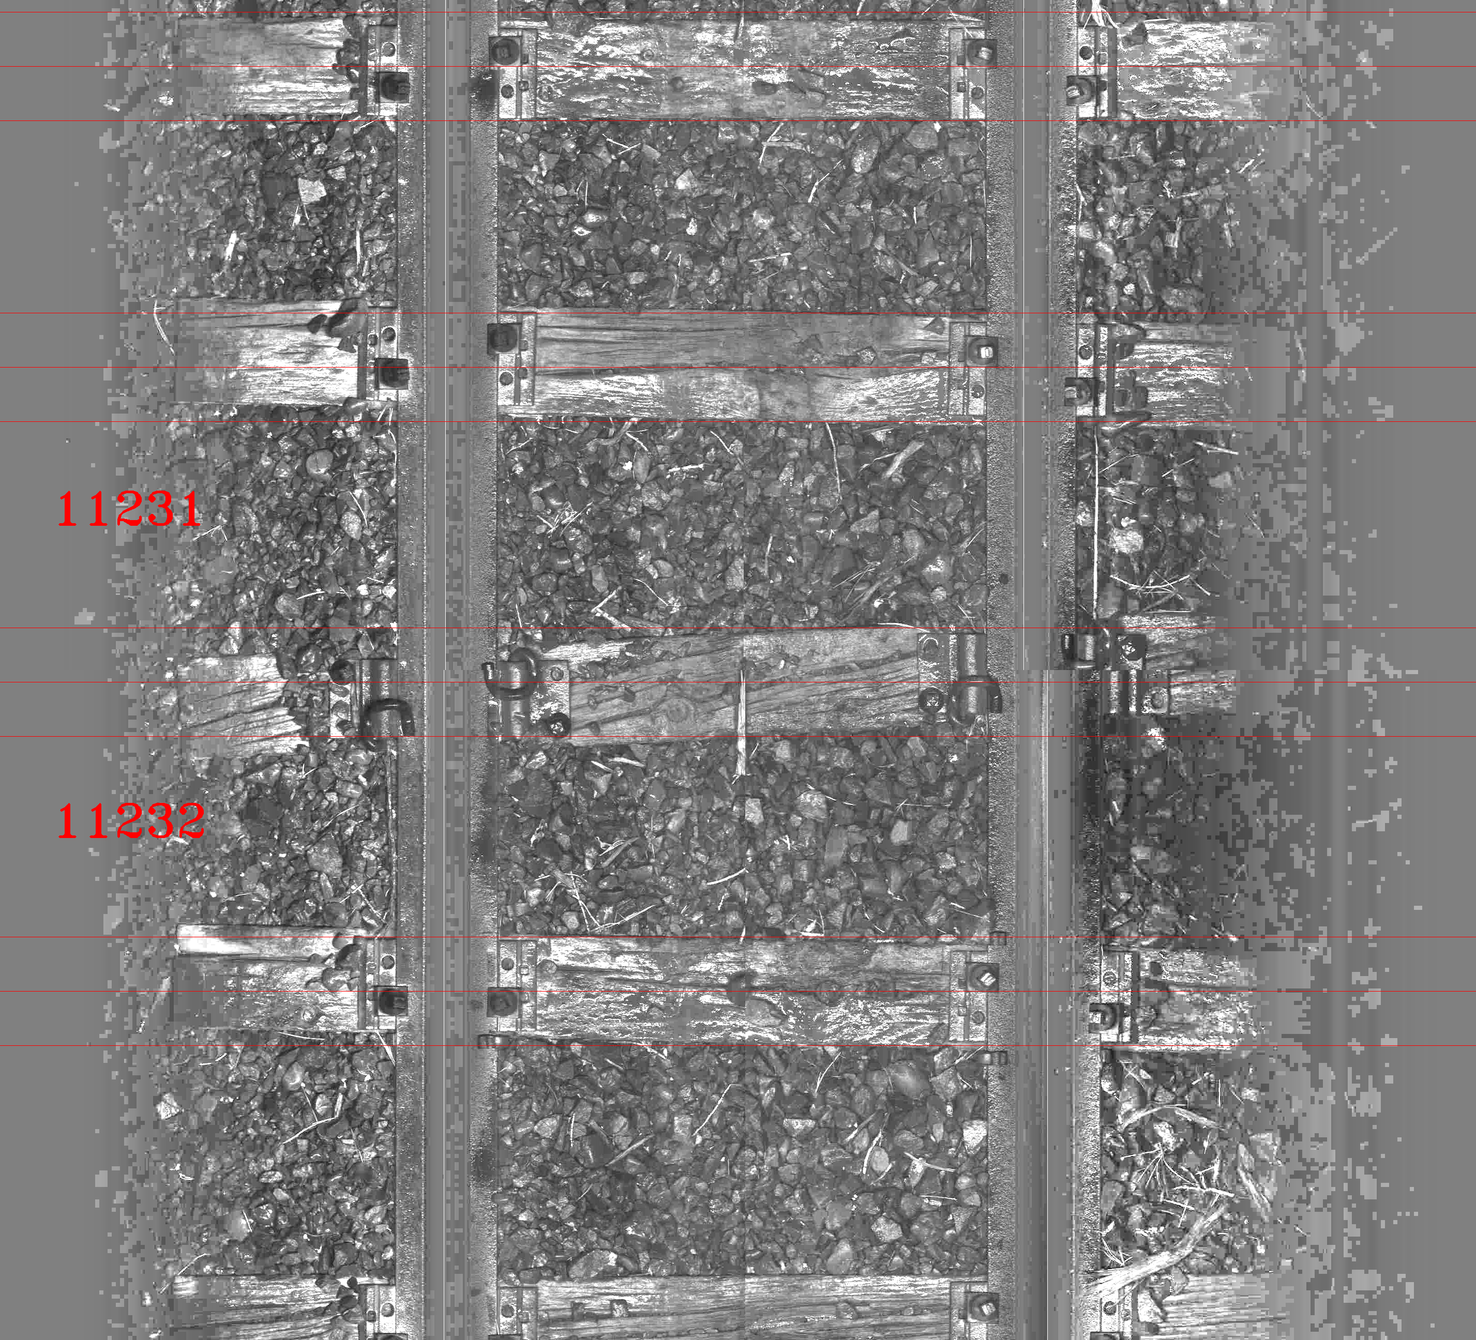
Crib Counting
In this case, two cribs are combined into a single crib, for example crib#11528

Slide 15
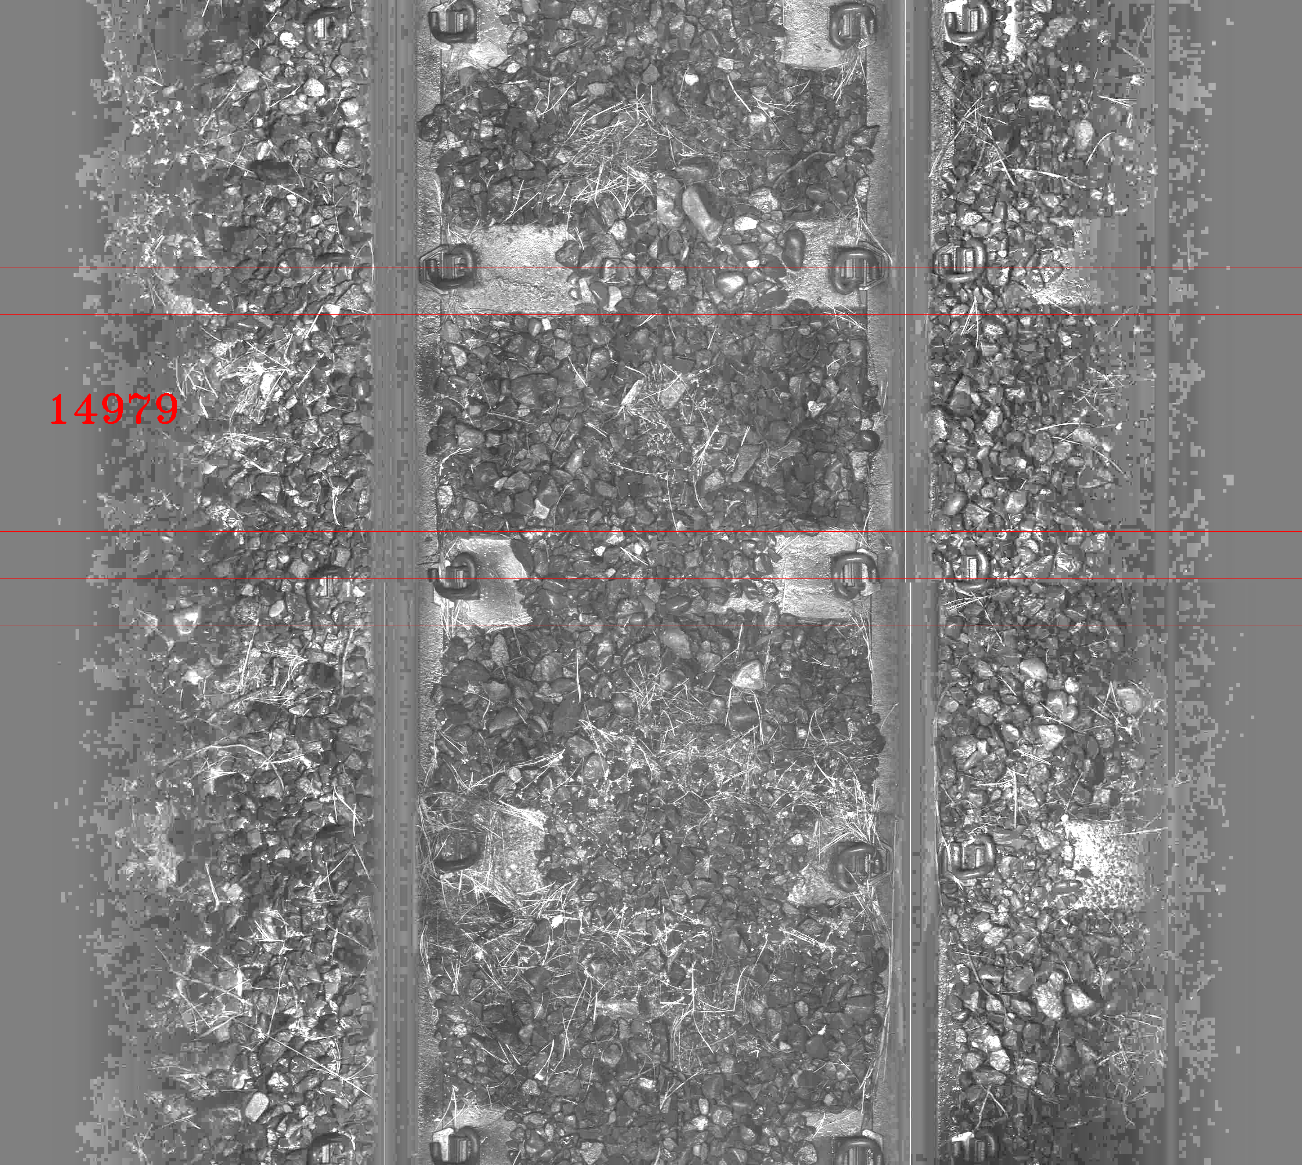
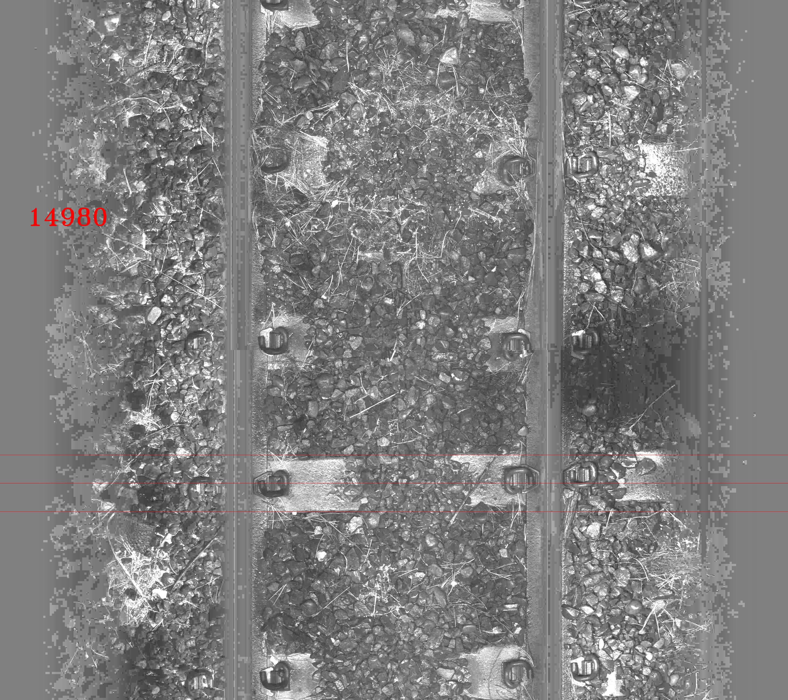
Crib Counting
If no sleeper is identified in the upper image, the crib section up to the first sleeper edge is exported as a single crib, for example crib# 14980.

Slide 16
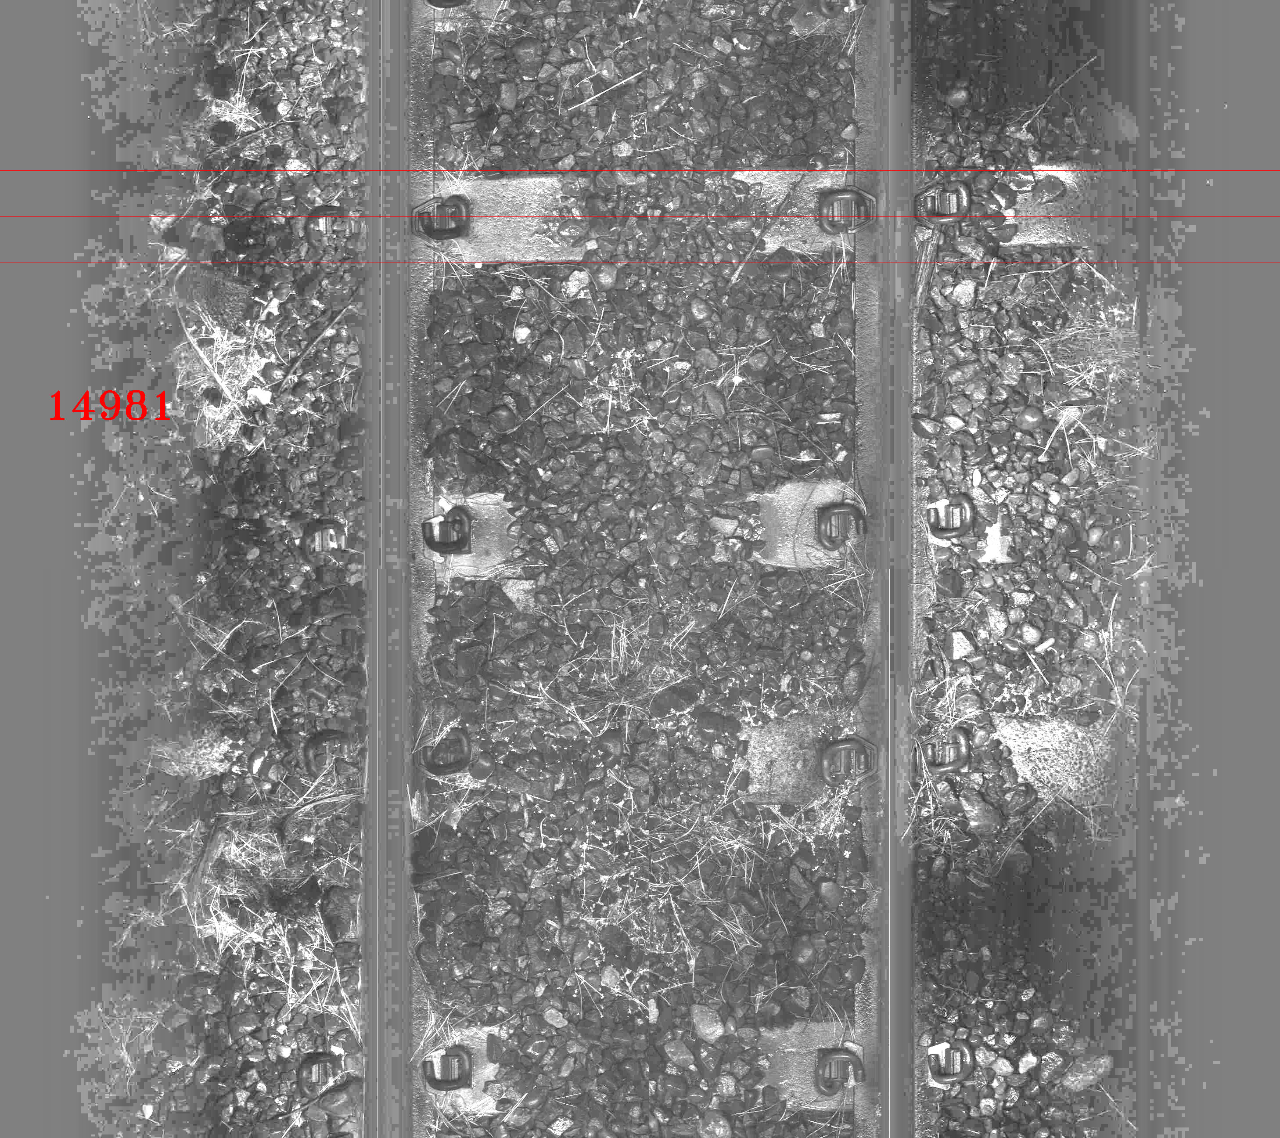
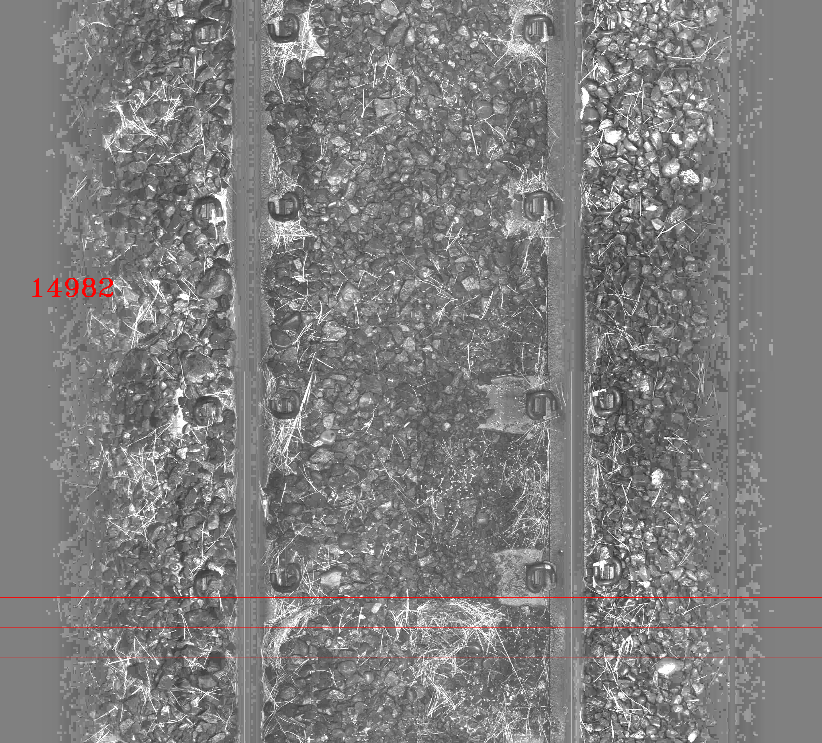
Crib Counting
When there is no sleeper identified in the lower image, the crib section starting from the last sleeper edge up to the last row of the first image is exported as a single crib, for example, crib# 14981.
When no sleeper is identified in the entire image, the crib section of the upper image is exported as a single crib, for example crib# 14982.

Slide 17
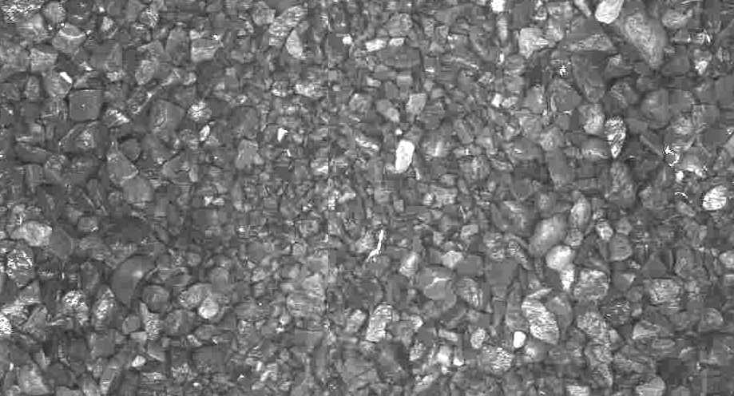
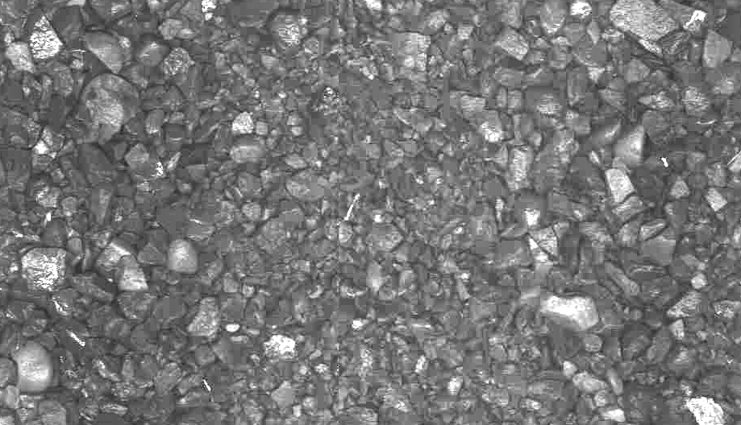
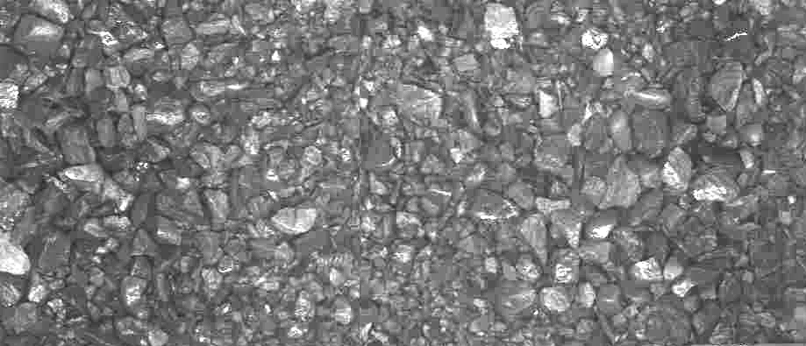
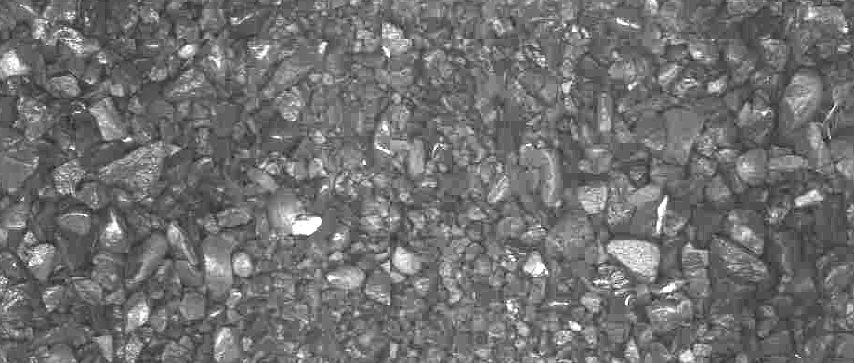
Extracting Cribs
Horizontal safety margin to allow the inaccuracy of rail centres
Vertical safety margin to allow different sleeper widths and angles.

Slide 18
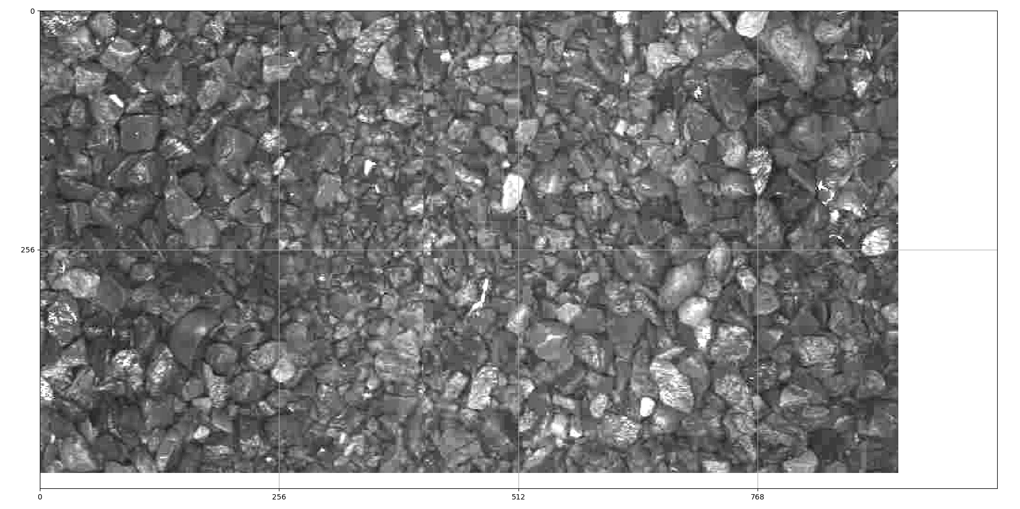
Segmentation into tiles with regular sizes
1. Regular 256x256 images. 2. Images with <70% content get ignored.
3. No need for large images as the pattern repeats over the entire image.

Slide 19
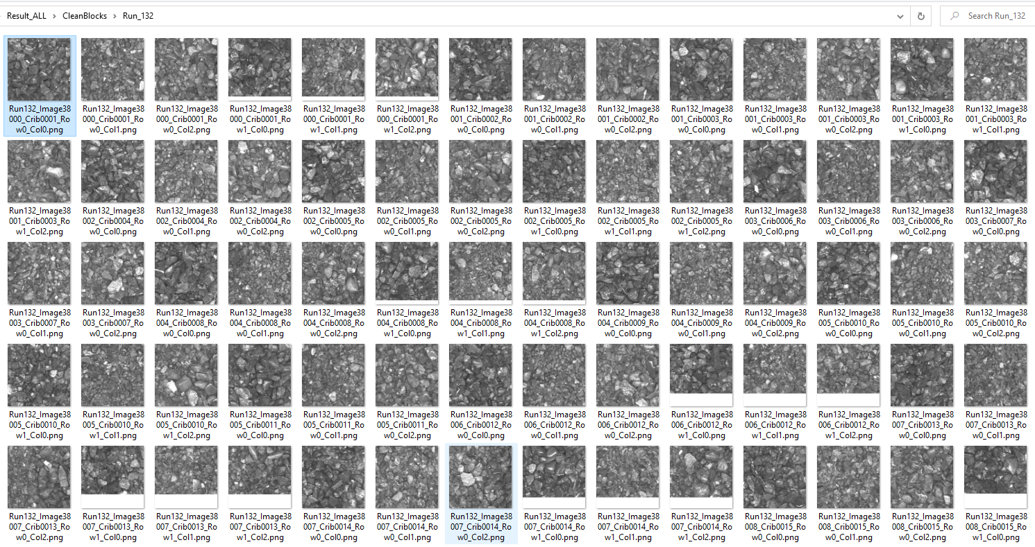
Prepare the Training/Testing images.
Run132_Image38000_Crib0001_Row0_Col0.png
Run132_Image38000_Crib0001_Row0_Col1.png
Run132_Image38000_Crib0001_Row0_Col2.png
Run132_Image38000_Crib0001_Row1_Col0.png
Run132_Image38000_Crib0001_Row1_Col1.png
Run132_Image38000_Crib0001_Row1_Col2.png
Run132_Image38001_Crib0002_Row0_Col0.png
Run132_Image38001_Crib0002_Row0_Col1.png
Run132_Image38001_Crib0002_Row0_Col2.png
Run132_Image38001_Crib0003_Row0_Col0.png
Run132_Image38001_Crib0003_Row0_Col1.png
Run132_Image38001_Crib0003_Row0_Col2.png
Run132_Image38001_Crib0003_Row1_Col0.png
Run132_Image38001_Crib0003_Row1_Col1.png
Run132_Image38001_Crib0003_Row1_Col2.png
Run132_Image38002_Crib0004_Row0_Col0.png
Run132_Image38003_Crib0006_Row0_Col1.png
Run132_Image38003_Crib0006_Row0_Col2.png

Slide 20
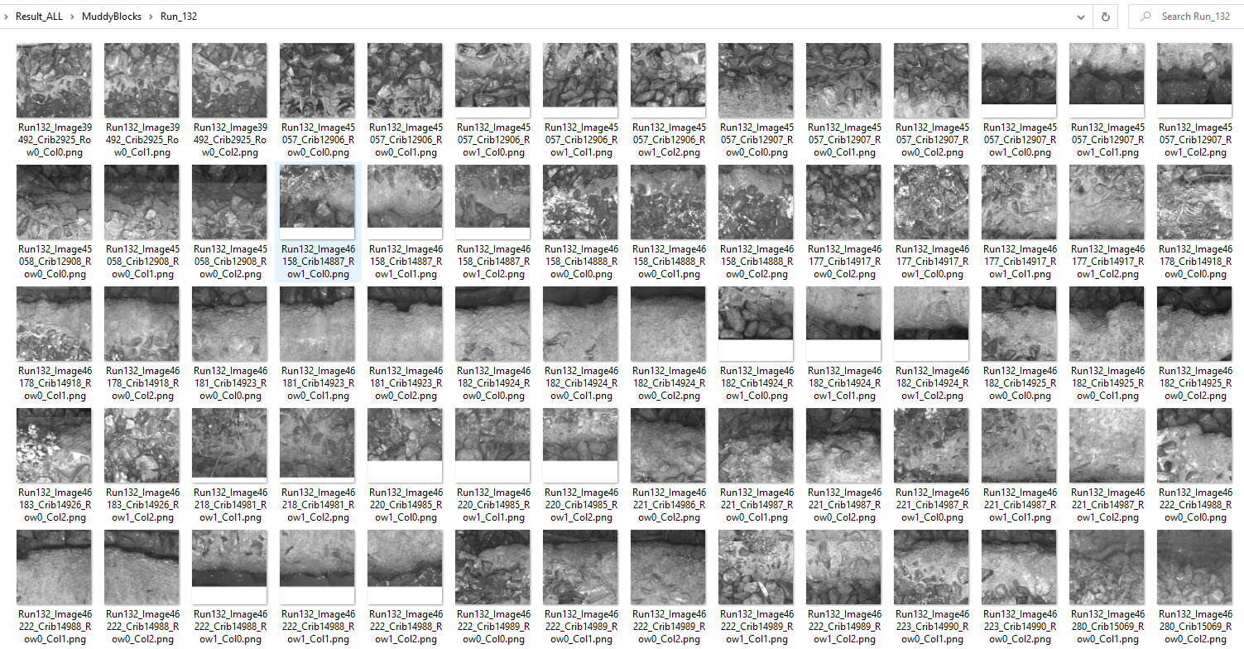
Prepare the Training/Testing Images
Run132_Image39492_Crib2925_Row0_Col0.png
Run132_Image39492_Crib2925_Row0_Col1.png
Run132_Image39492_Crib2925_Row0_Col2.png
Run132_Image45057_Crib12906_Row0_Col0.png
Run132_Image45057_Crib12906_Row0_Col1.png
Run132_Image45057_Crib12906_Row1_Col0.png
Run132_Image45057_Crib12906_Row1_Col1.png
Run132_Image45057_Crib12906_Row1_Col2.png
Run132_Image45057_Crib12907_Row0_Col0.png
Run132_Image45057_Crib12907_Row0_Col1.png
Run132_Image45057_Crib12907_Row0_Col2.png
Run132_Image45057_Crib12907_Row1_Col0.png
Run132_Image45057_Crib12907_Row1_Col1.png
Run132_Image45057_Crib12907_Row1_Col2.png
Run132_Image45058_Crib12908_Row0_Col0.png
Run132_Image45058_Crib12908_Row0_Col1.png
Run132_Image45058_Crib12908_Row0_Col2.png

Slide 21
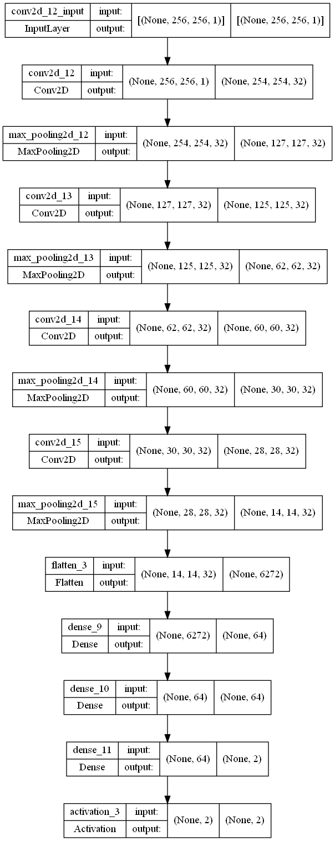
CNN Structure
Input is a fixed 256x256 grayscale image.
Basic convolution structure: 32 * (3,3) convolution layer + (2,2) maxpooling
Repeat the structure 3 times to bring the size down to 12 by 12 with 32 channels. (6272 features altogether).
6272→64→64→2 fully connected layers for feature selection.

Slide 22
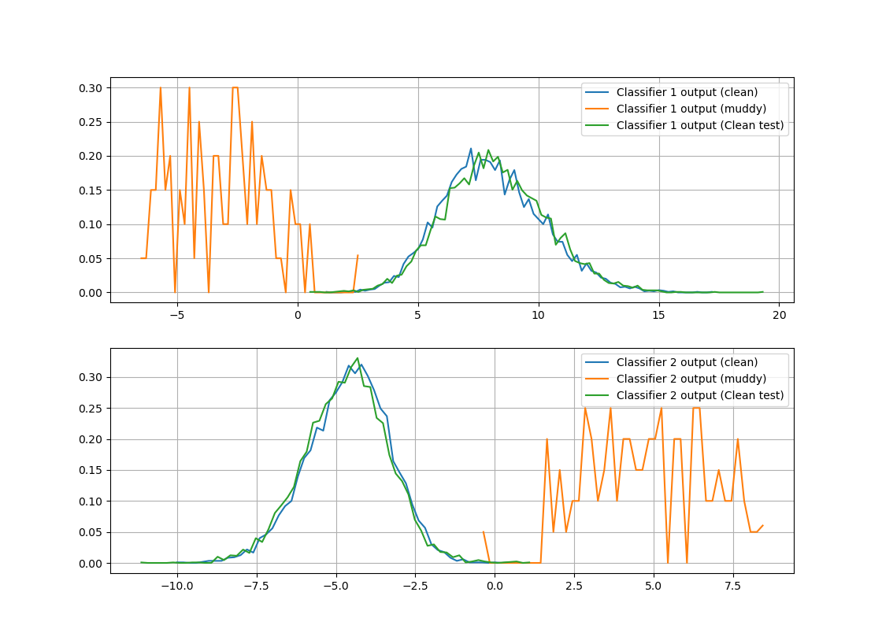
Training/Testing Results
The focus is on the clean crib feature, which can be characterised.
Whereas muddy crib feature can vary significantly.
The aim is to find the best feature to classify clean cribs with confidence.

Slide 23
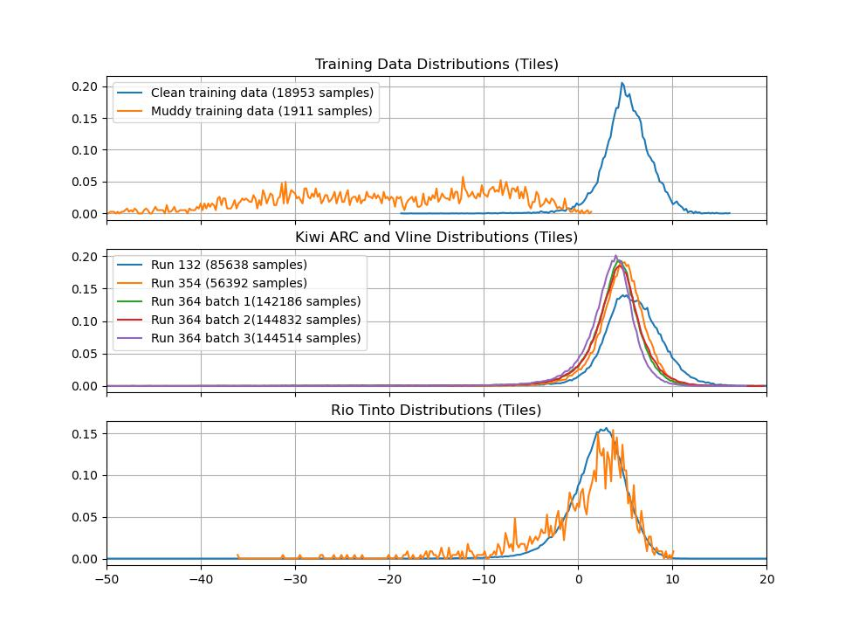
Testing Results
Need more training data for the mud sport category.
Good consistency between runs. ☺
Bad separation in the Rio Tinto run. ☹

Slide 24
Testing Results
Labelling rule for each frame: at least one tile is predicted as mud spot.
False Negative: Ranked as mud (SMI=3) but predicted by CNN as clean.
False Positive: Ranked as clean (SMI=1) but predicted by CNN as mud.
Run# | Total number of Images | Start# | End# | Number of extracted cribs | Number of cut blocks | Labelled Clean | Ranked Mud | False negatives% | Labelled Mud | Ranked Clean | False Positive% | Used for CNN traning
132 | 10,000 | 38000 | 47999 | 19,957 | 85,638 | 9,364 | 1.00 | 0.01 | 637 | 389.00 | 61 | Small subset
354 | 5,500 | 8000 | 13499 | 10,622 | 56,392 | 5,091 | 5.00 | 0.10 | 409 | 385.00 | 94 | Small subset
364 batch1 | 10,001 | 52000 | 62000 | 19,041 | 142,186 | 8,318 | 0.00 | 0.00 | 1,683 | 1436.00 | 85 | Small subset
364 batch2 | 10,000 | 70000 | 79999 | 18,890 | 144,832 | 8,528 | 48.00 | 0.56 | 1,473 | 1225.00 | 83 | No
364 batch3 | 10,001 | 85000 | 95000 | 18,918 | 144,514 | 8,104 | 15.00 | 0.19 | 1,897 | 1694.00 | 89 | No

Slide 25
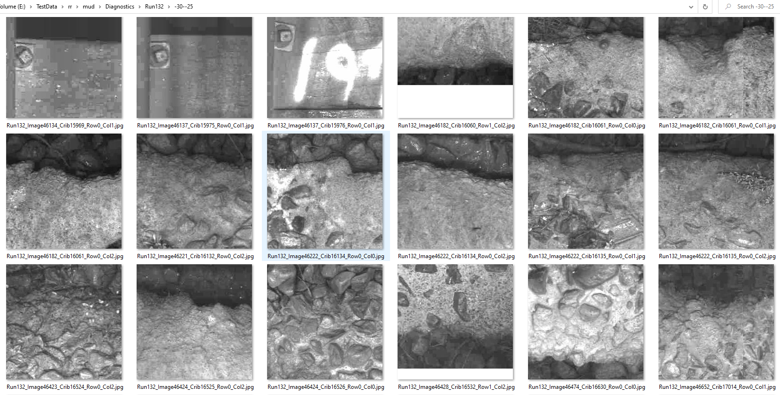
Classification Value Range -30→-25

Slide 26
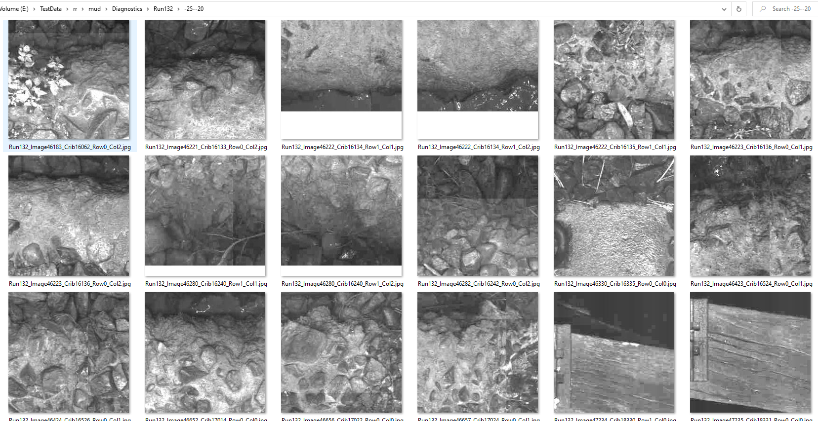
Classification Value Range -25→-20

Slide 27
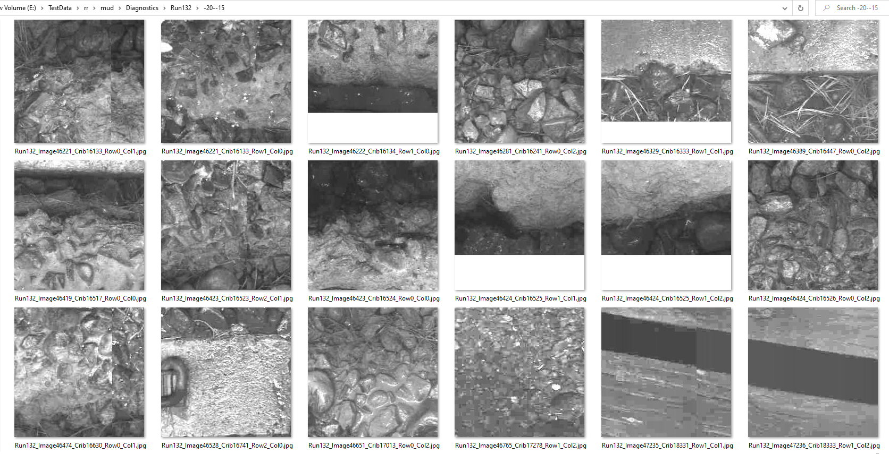
Classification Value Range -20→-15

Slide 28
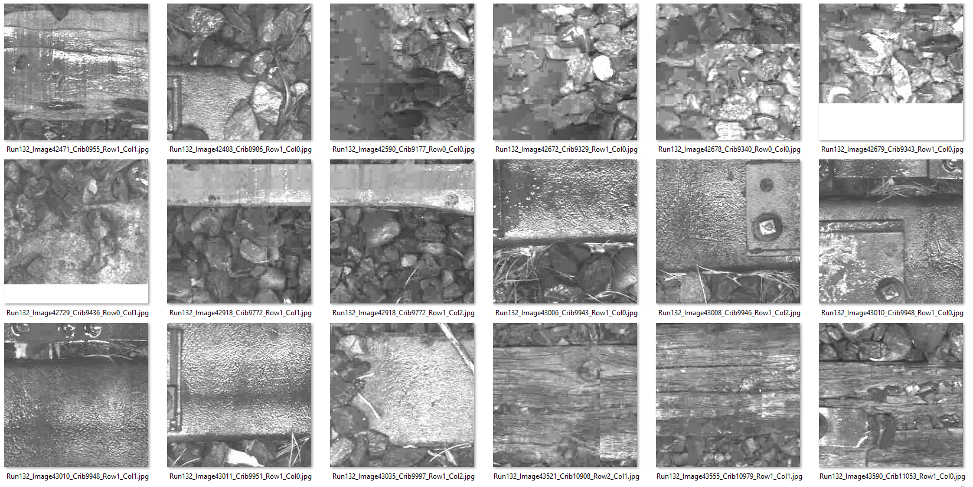
Classification Value Range -15→-10

Slide 29
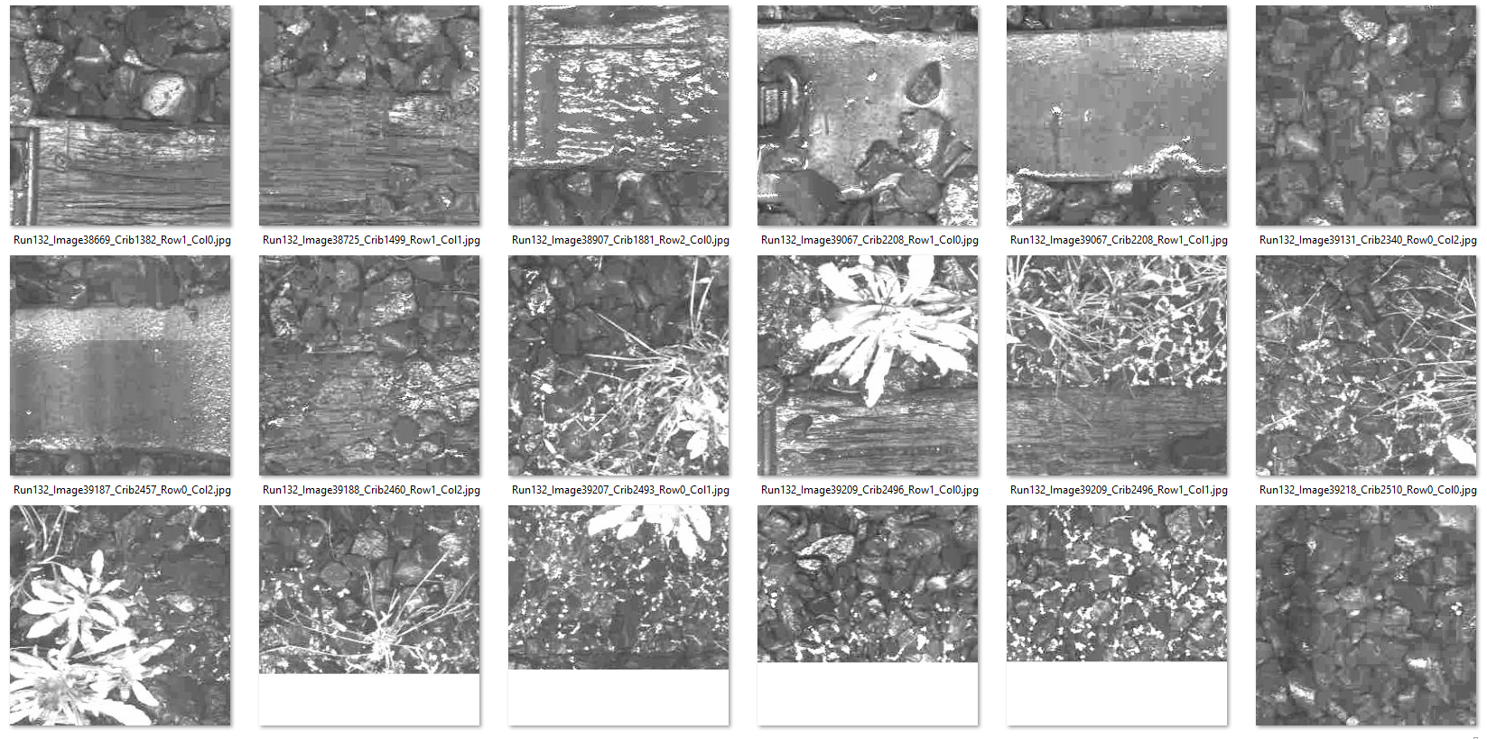
Classification Value Range -10→-5

Slide 30
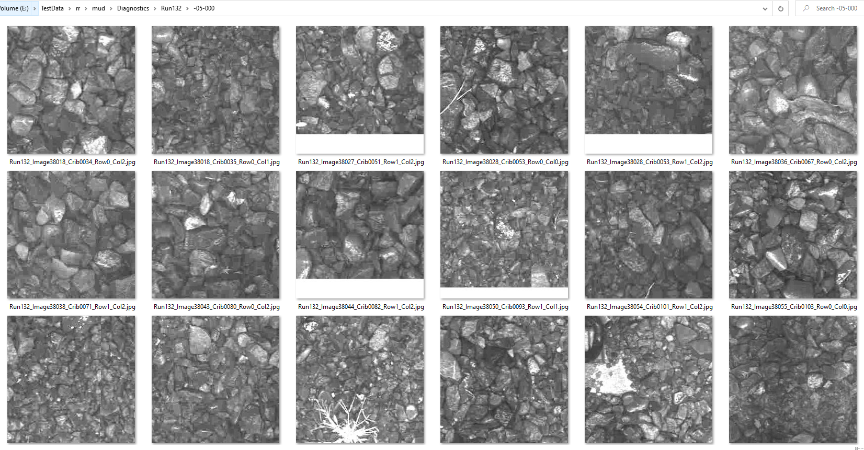
Classification Value Range -5→0

Slide 31
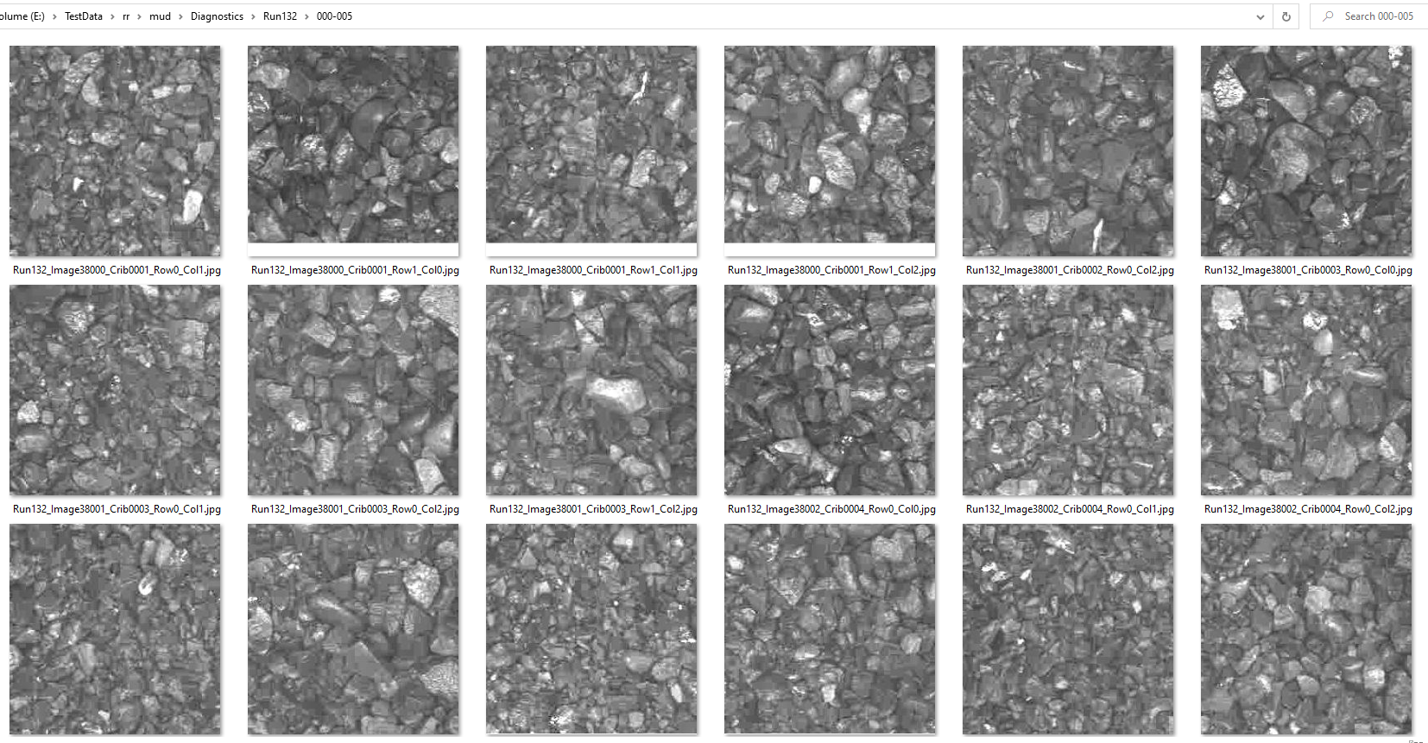
Classification Value Range 0→5

Slide 32
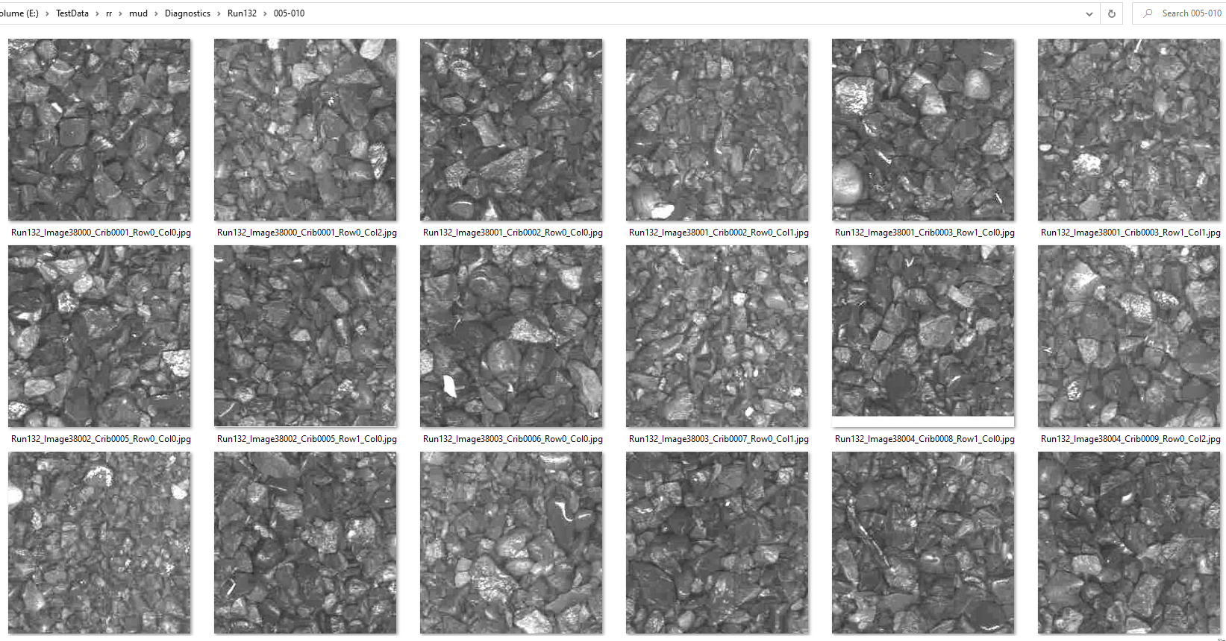
Classification Value Range 5→10

Slide 33
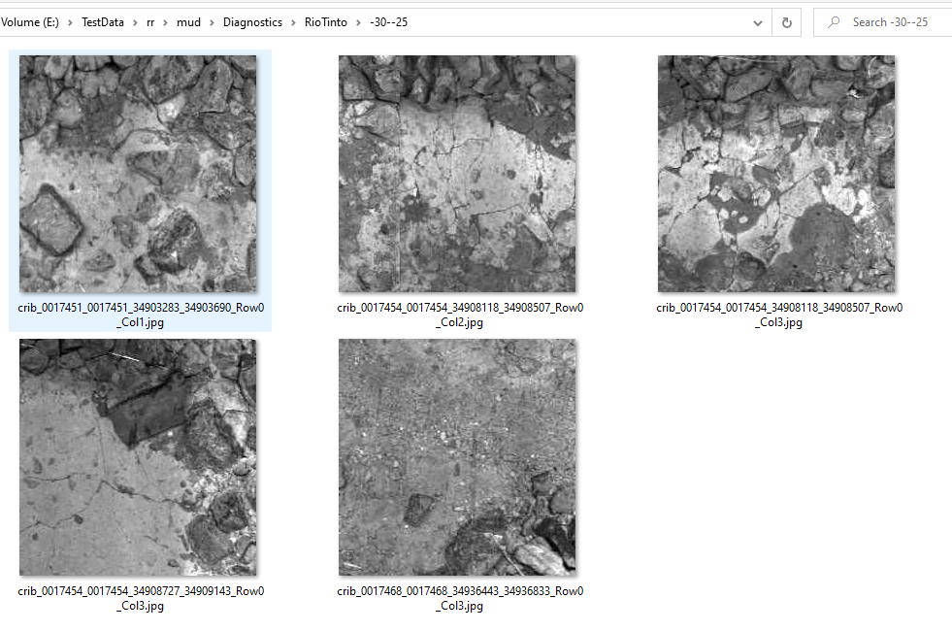
Rio Tinto Classification Value Range -30→-25

Slide 34
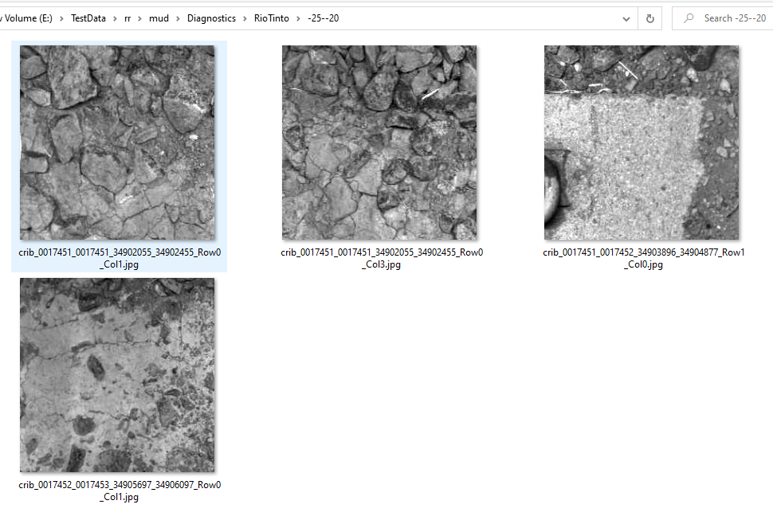
Rio Tinto Classification Value Range -25→-20

Slide 35
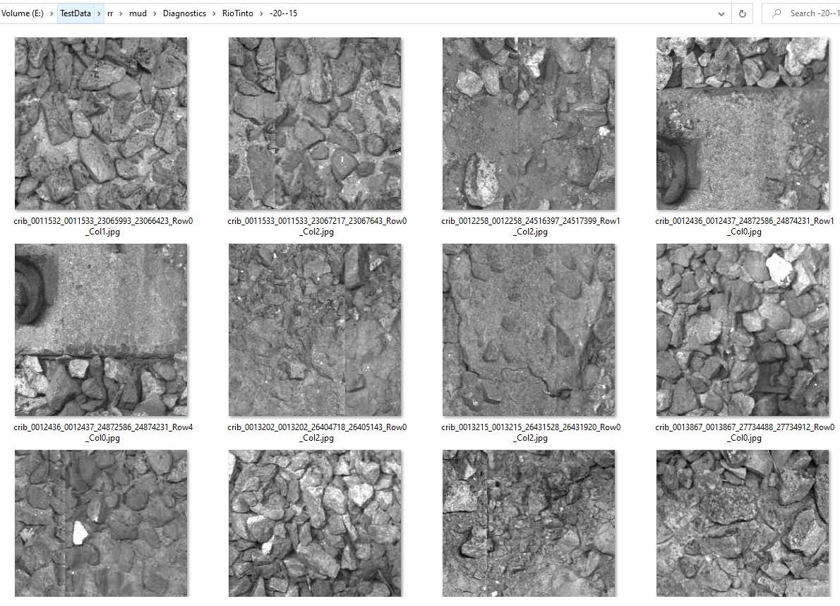
Rio Tinto Classification Value Range -20→-15

Slide 36
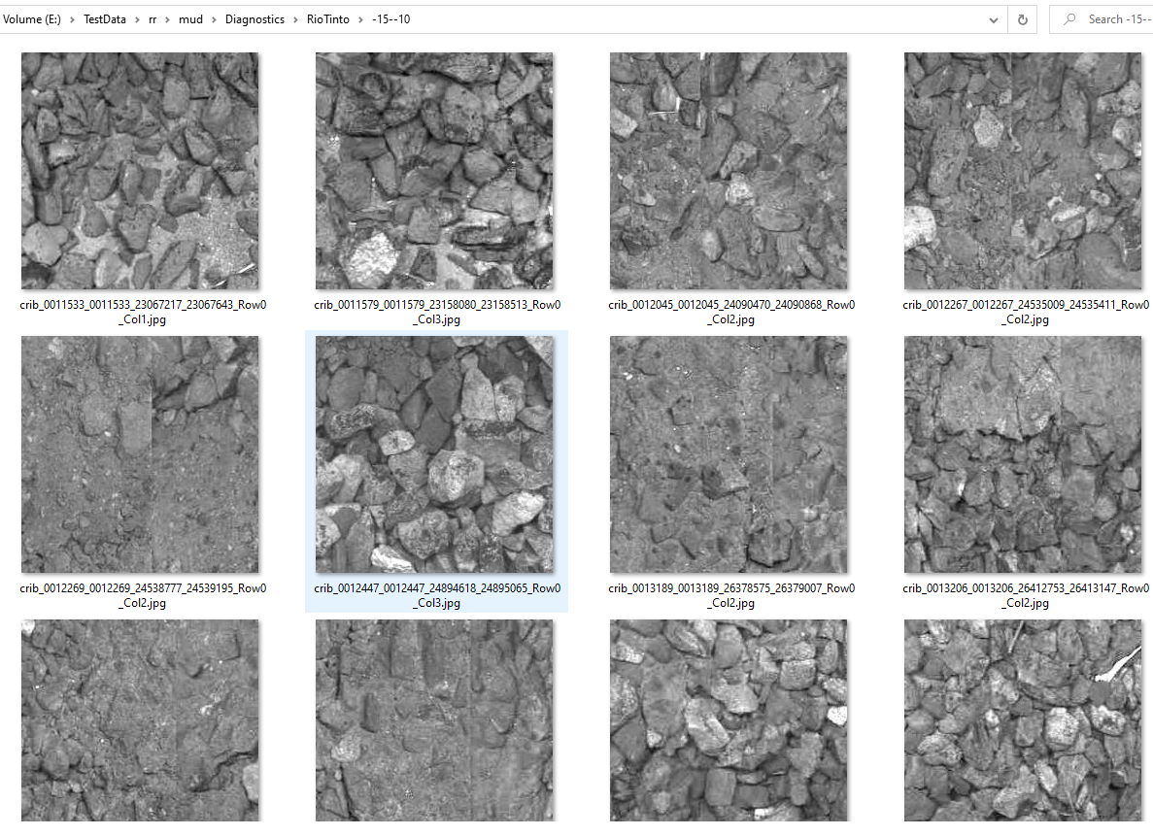
Rio Tinto Classification Value Range -15→-10

Slide 37
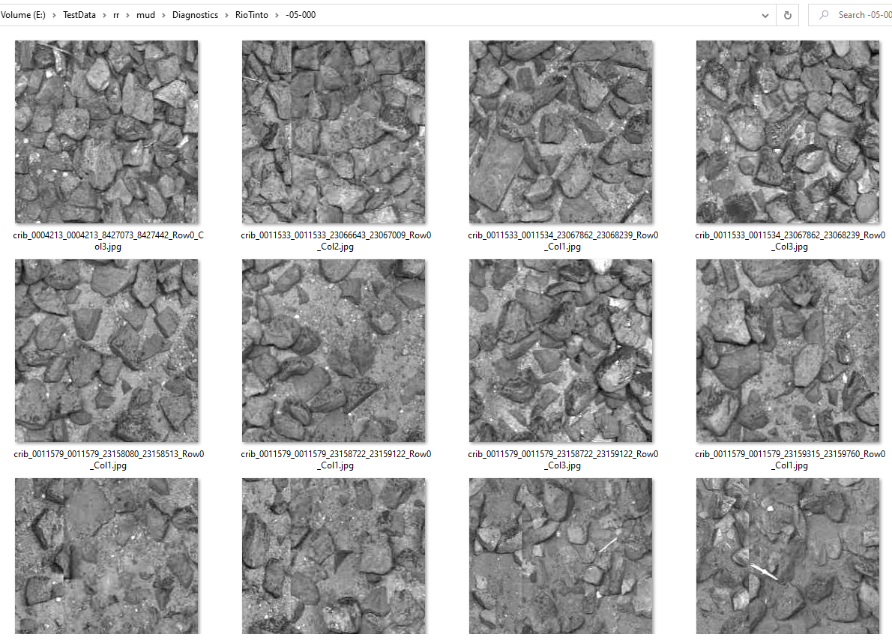
Rio Tinto Classification Value Range -5→0

Slide 38
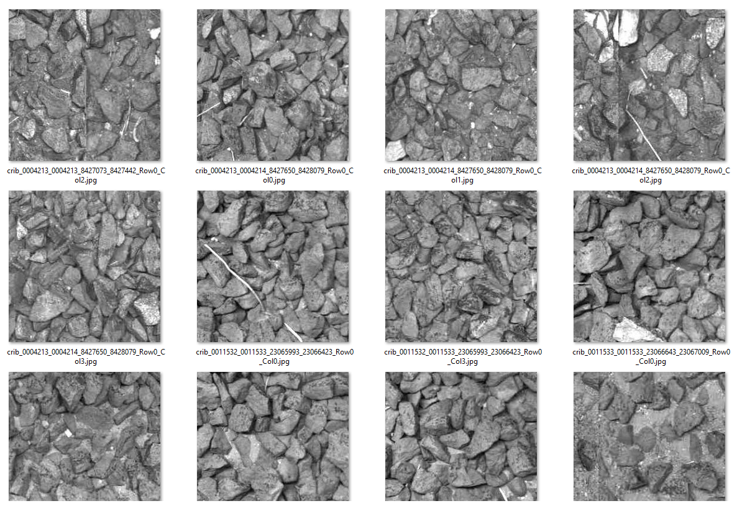
Rio Tinto Classification Value Range 0→5

Slide 39
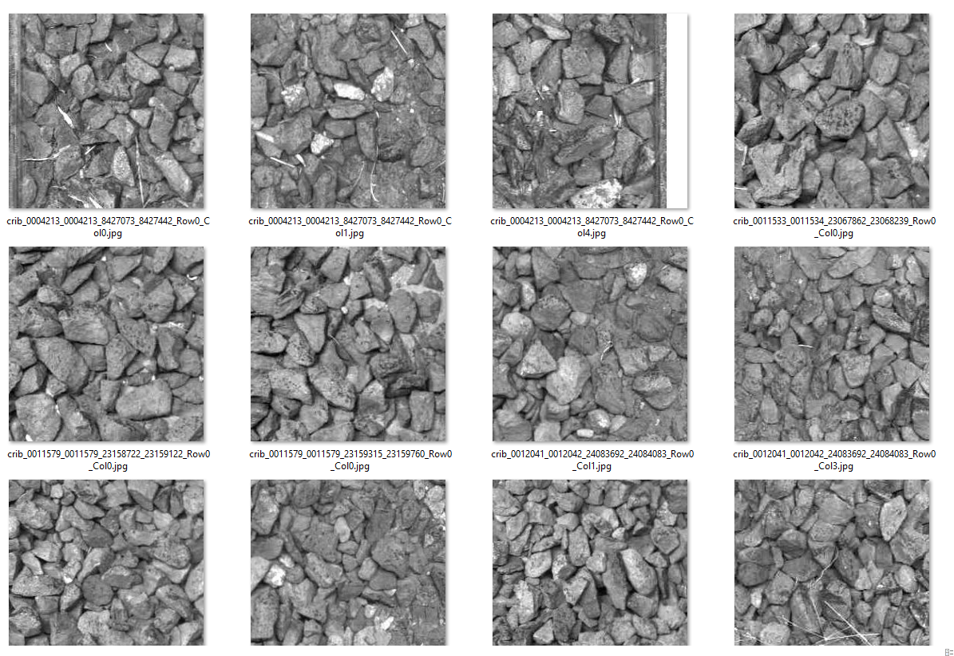
Rio Tinto Classification Value Range 5→10

Slide 40
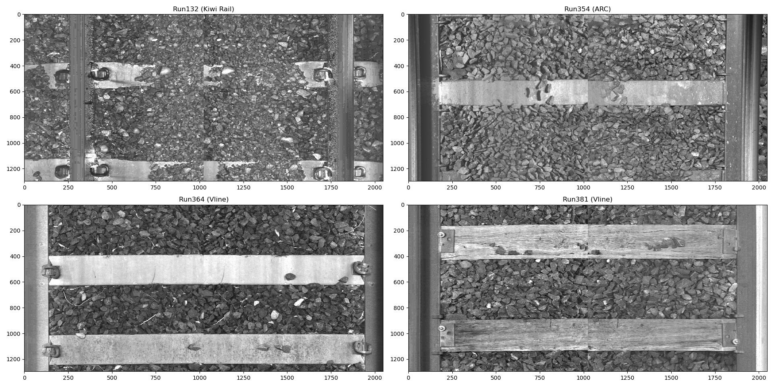
Crib Image Size (Track Gauges)
Kiwi rail has narrow Gauge of 1067mm.
ARC and Vline have standard gauge of 1435mm.
Average crib image height is 450mm determined by the tacho setting.
100mm on each side to remove the rail sections.

Slide 41
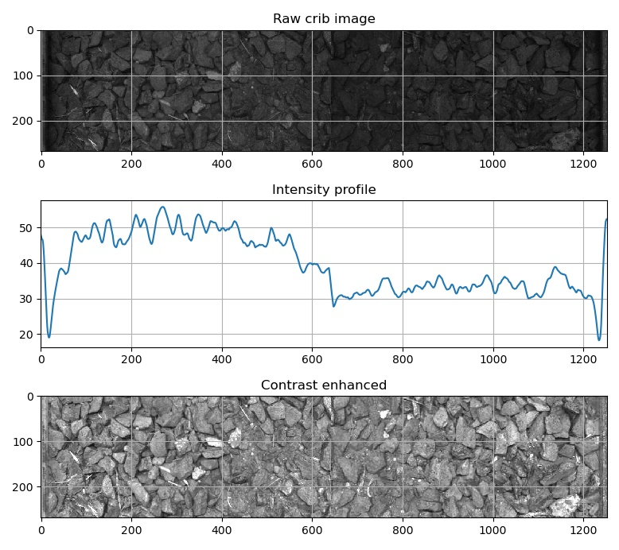
Crib Image Intensity Equalisation (Rio Tinto)
Non-uniform illumination
Correction by intensity profile estimation.

Slide 42
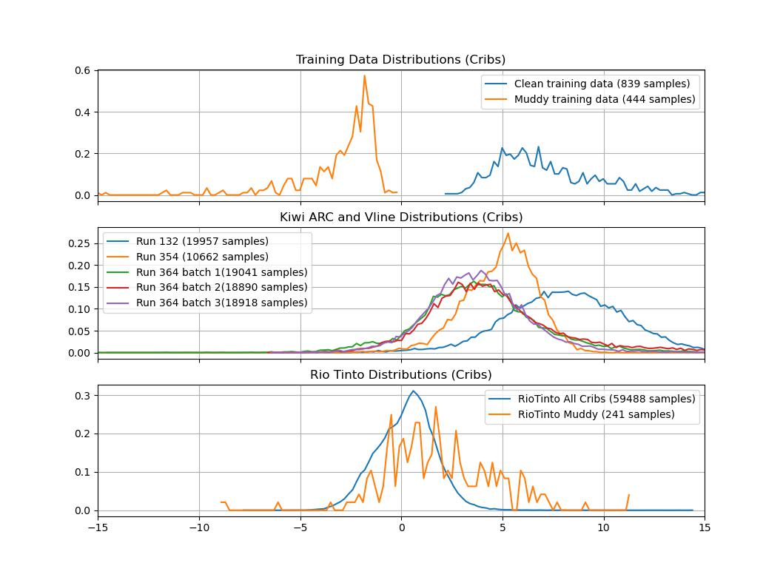
Crib Classifications
Well-separated training data ☺
Reasonable consistency between runs. ☺
Bad separation for Rio Tinto data. ☹

Slide 43
Crib Classification Results
Run# | Total number of Images | Start# | End# | Number of extracted cribs | Labelled Clean | Ranked Mud | False negatives% | Labelled Mud | Ranked Clean | False Positive% | Used for CNN training
132 | 10,000 | 38000 | 47999 | 19,957 | 9943 | 0 | 0.00 | 58 | 3 | 5.17 | Small subset
354 | 5,500 | 8000 | 13499 | 10,622 | 5496 | 0 | 0.00 | 35 | 23 | 65.71 | Small subset
364 batch1 | 10,001 | 52000 | 62000 | 19,041 | 9246 | 0 | 0.00 | 755 | 534 | 70.73 | Small subset
364 batch2 | 10,000 | 70000 | 79999 | 18,890 | 9618 | 203 | 2.11 | 383 | 324 | 84.60 | No
364 batch3 | 10,001 | 85000 | 95000 | 18,918 | 9599 | 111 | 1.16 | 402 | 352 | 87.56 | No

Slide 44
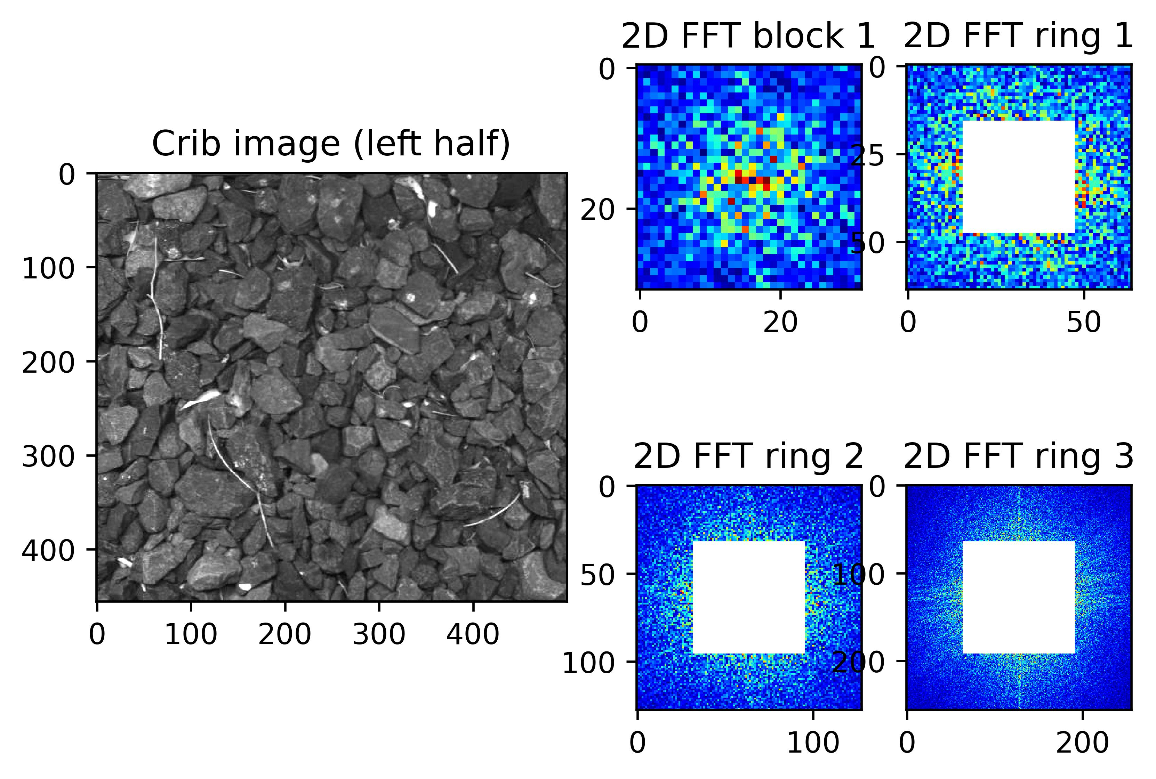
2D-FFT + CNN?
Clean Crib

Slide 45
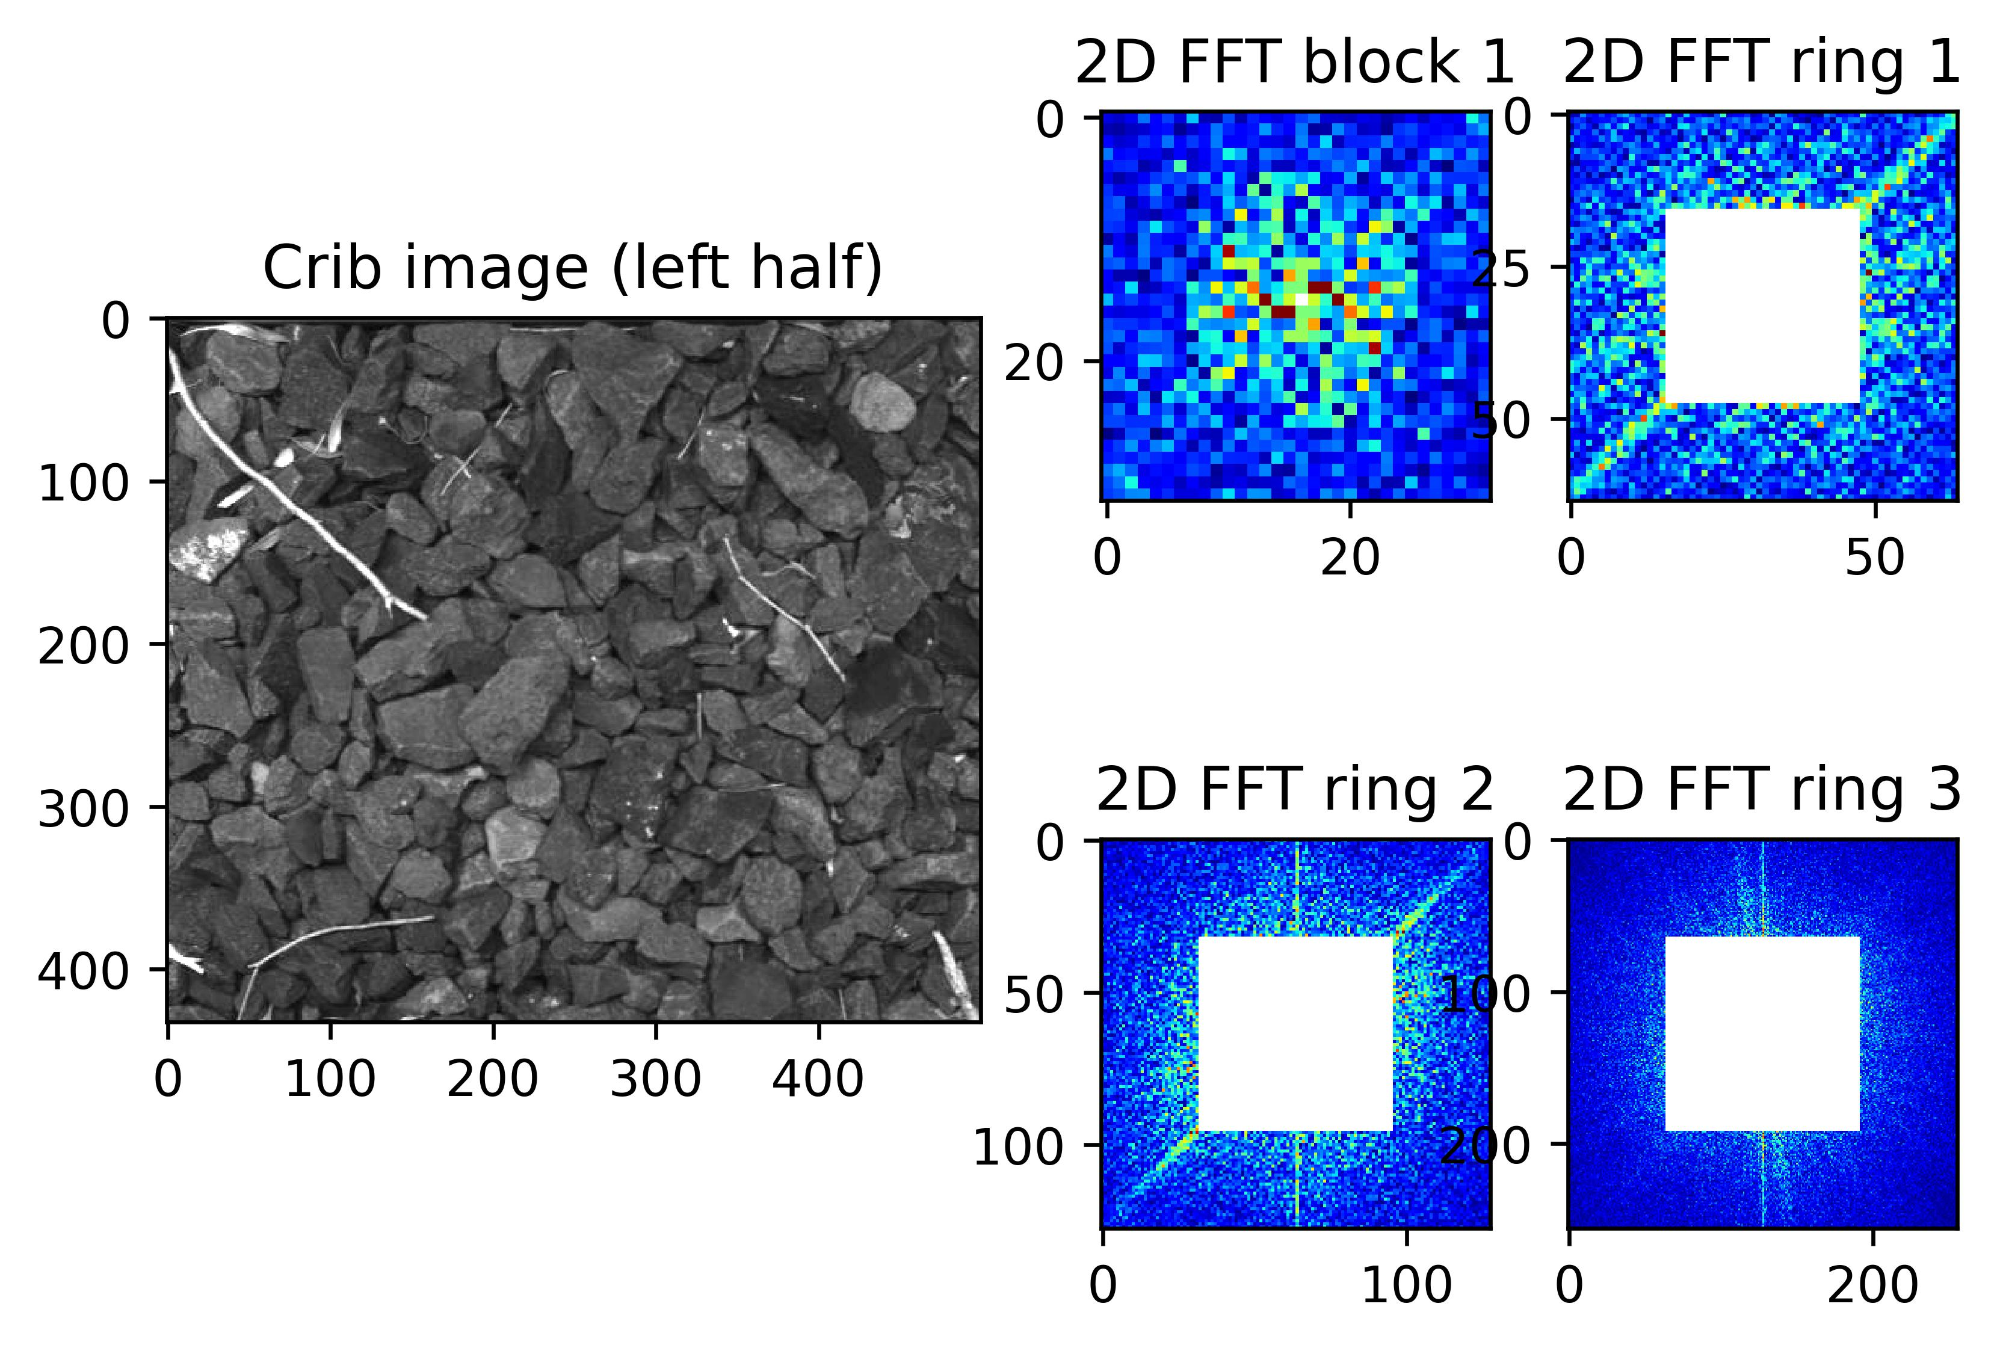
2D-FFT + CNN?
Clean with vegetation

Slide 46
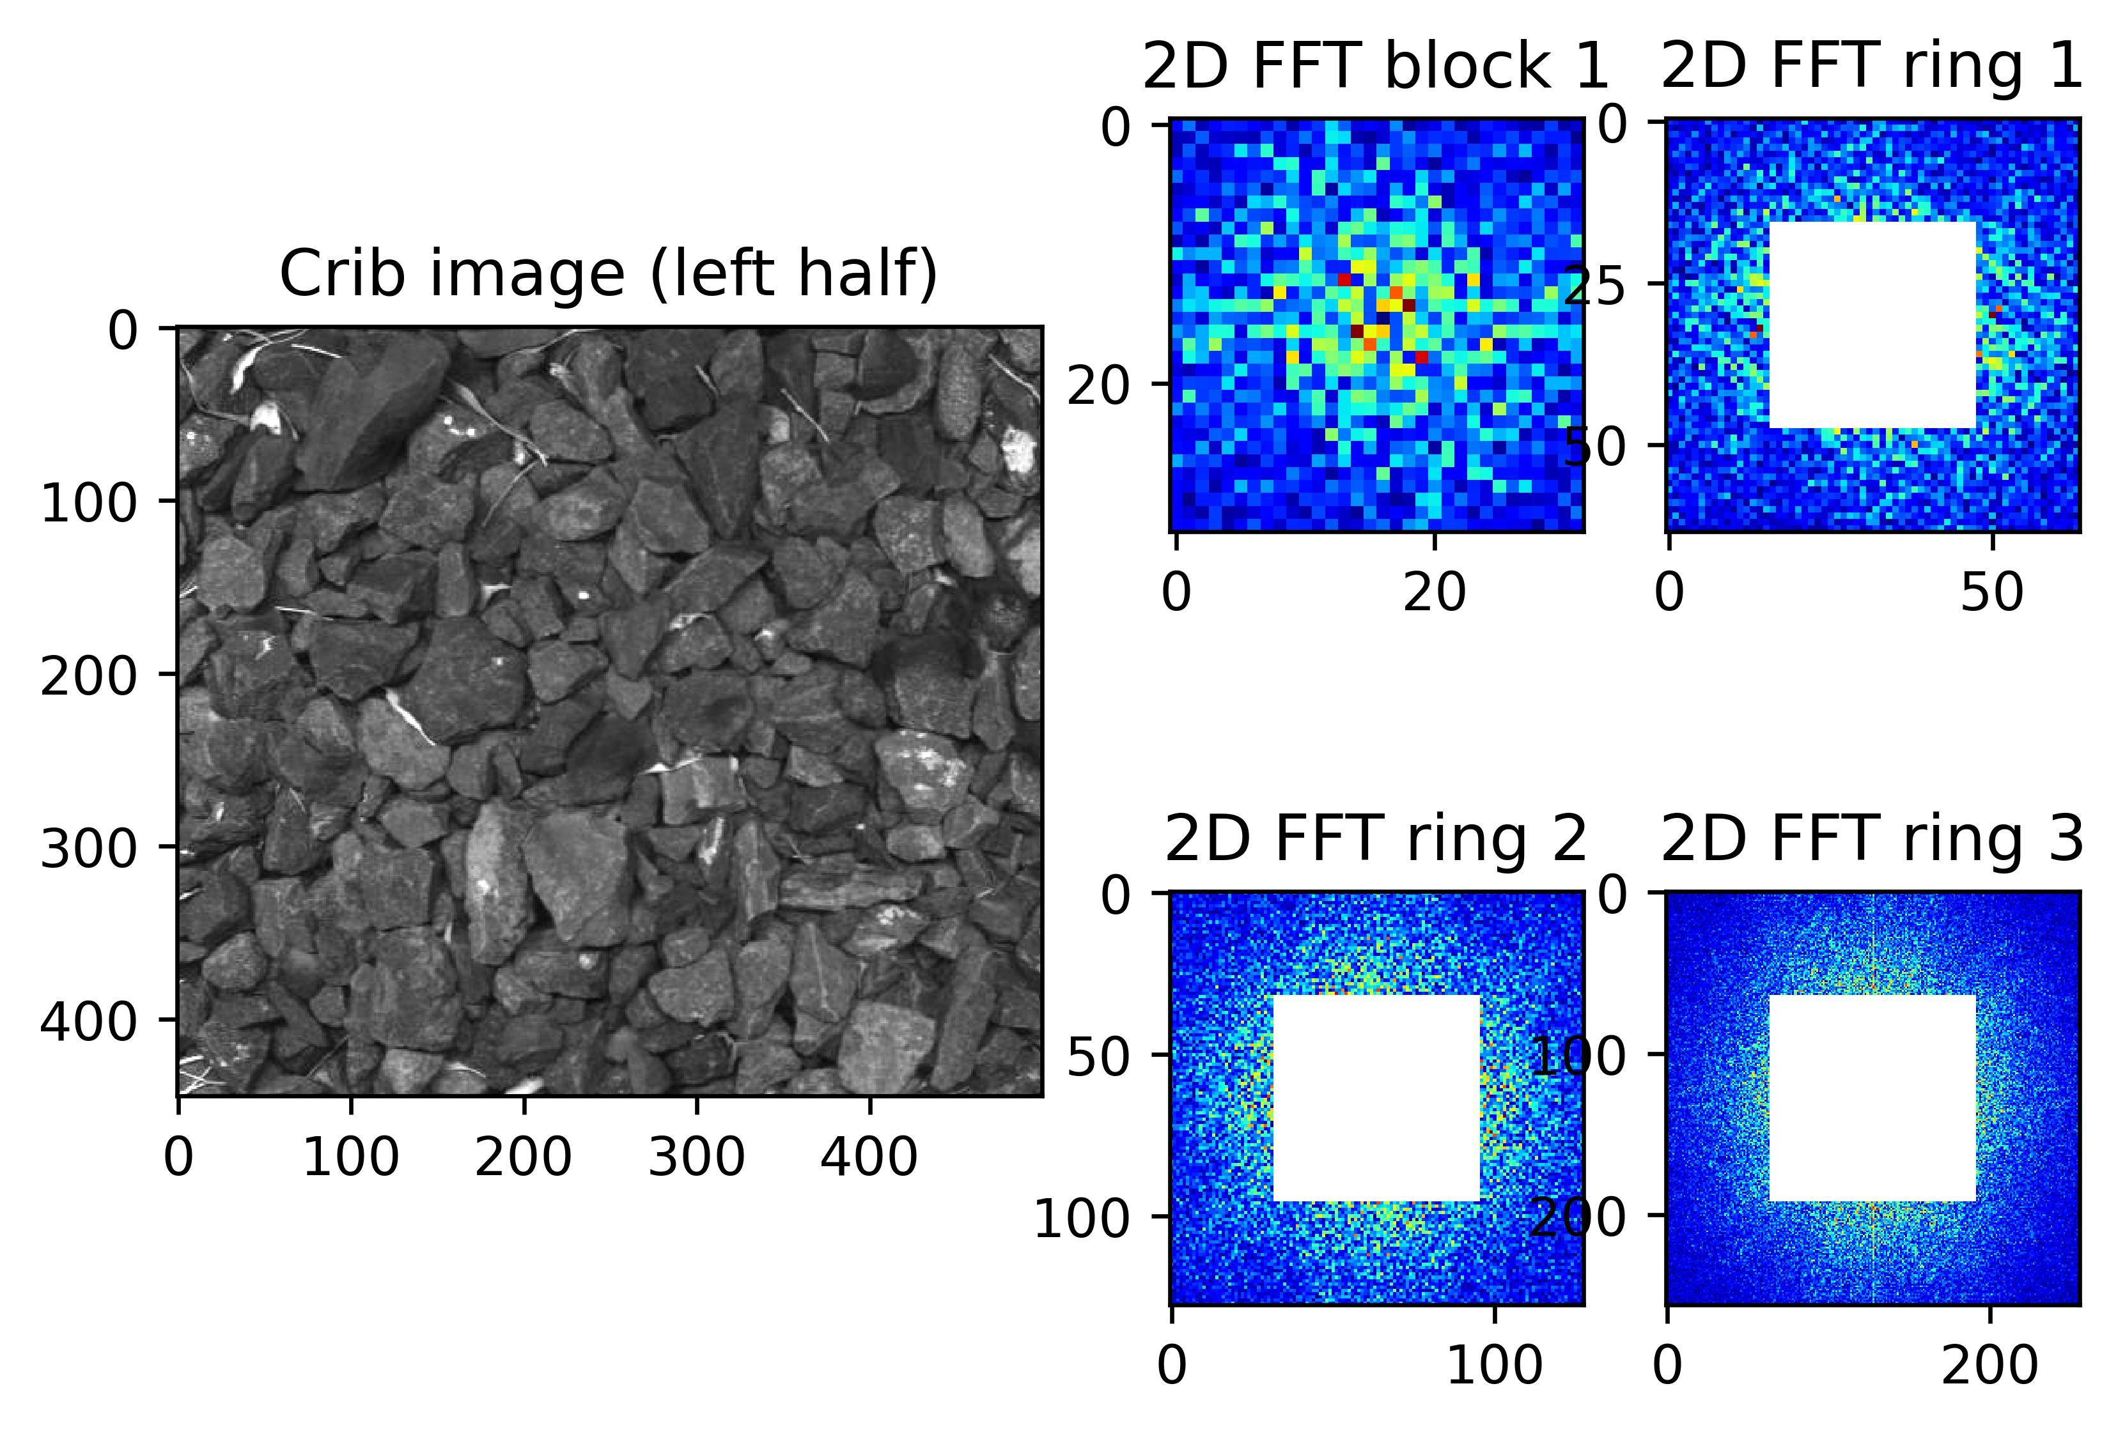
2D-FFT + CNN?
Clean

Slide 47

2D-FFT + CNN?
Muddy

Slide 48

2D-FFT + CNN?
Muddy

Slide 49

2D-FFT + CNN?
Muddy

Slide 50
Further Work
Ranking for each crib?
Improve quality of the training data.
Include Rio Tinto muddy spots images into the Training data.
Investigate 2D-FFT+CNN performance.

Slide 51
Questions?

